Slide 1

The Swiss Landscape of Open Science
The EOSC Lustrum, Vienna 19.10.2023
Dr. Anna Fill, State Secretariat for Education, Research and Innovation
Notes:
Dear Ladies and Gentleman, also from my side a warm welcome. As already announced, I will present the Swiss Landscape of Open Science today.

Slide 2

Index
Overview of the Swiss landscape in Open Science
Swiss activities in EOSC
Swiss National activities on Open Science
Status quo and future tasks
Notes:
What are you going to hear in today? I will start by providing you a quick overview of the broad landscape of open science activities in Switzerland. I will start

Slide 3
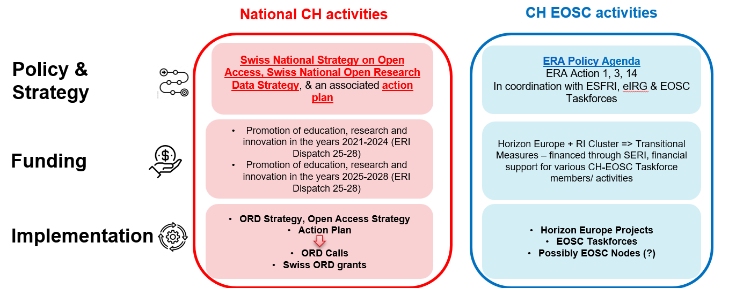
The Swiss Open Science Landscape
CH strongly supports open science policy
CH has a unique open science landscape displaying a national approach as well as complementary, European approach

Slide 4
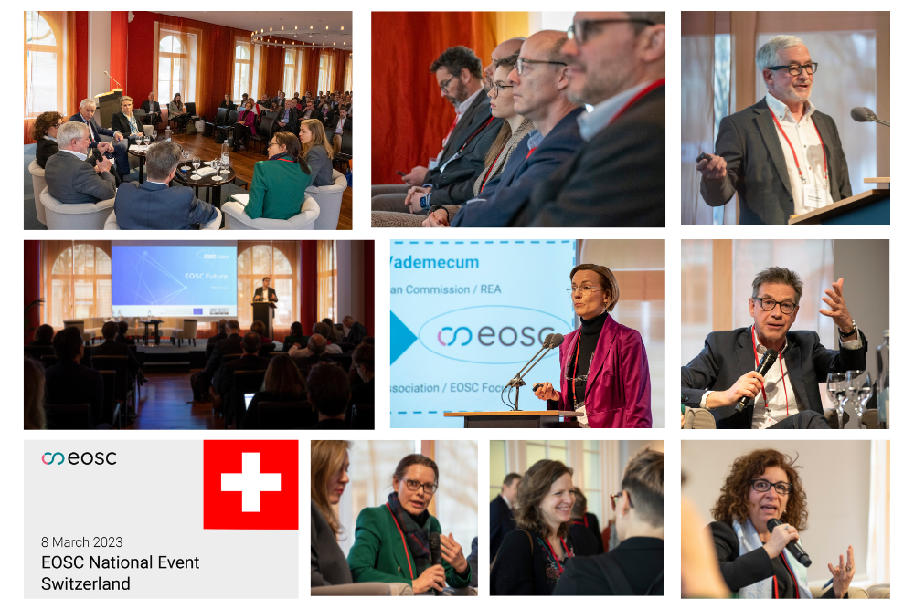
Swiss Status in HEU
Switzerland is currently a non-associated third country in HEU
At the moment there is no Swiss participation in the ERA Governance including the EOSC Steering board
However – CH is a very active member in the EOSC Association
Strong political support for EOSC from CH
E.g. EOSC National Event
Switzerland, 08.03.2023
CH pushes and aims for an
HEU association
Notes:
=> but in the future maybe also a Swiss Lustrum event when we are associated
Political Goal =>
full association HEU
(working hard)

Slide 5







Swiss Activities in EOSC
Mandated Organisation
EOSC Members
EOSC Observers
Swiss Members in EOSC Taskforces: Data Stewardship Curricula and Career Paths, Research Careers, Recognition and Credit, Upskilling Countries to engage in EOSC, Defining Funding Models for EOSC, Long-term Data Preservation, Defining Funding Models for EOSC, Infrastructure for Quality Research Software, Technical Interoperability of Data and Services
Notes:
Obwohl wir aussgeschlossen sind => sind wir überall dabei => members sind dabei => wir möchten darauf aufbauen,

Slide 6

Swiss Activities in EOSC
Monthly meetings, CH EOSC community
Representatives in several taskforces, RI members
Based on Austrian Example EOSC Coffees
  1st EOSC Coffee: data challenges in the life sciences (Elixir Sweden, SIB), September 2023.
  2nd EOSC Coffee: EOSC Nodes / Federation (EOSC-A, SWITCH, ETHZ), November 2023 upcoming.
Work towards an CH-EOSC - Node
  1st Swiss EOSC Nodes / Federation Workshop, organised by SWITCH
  ETHZ communicated Swiss perspectives based on this workshop to EOSC Community Workshop Mandated Organisations
Stronger alignment and creation of synergies of ORD & EOSC

Slide 7
Selected EOSC Projects
PaNOSC& ExPaNDS: Photon and Neutron Open Science Cloud for FAIR data in 6 European Research Infrastructures (RIs) -> services for scientific data and connecting these to EOSC.
European Open Science Cloud Photon and Neutron Data (PaN) Services: support and develop data policies and services for 10 RIs in the PaN research community (PSI).
FAIRCORE4EOSC: Development & realisation of nine core components necessary to enable a FAIR EOSC ecosystem. Case studies in Climate Change, EOSC Service Providers & RDM Communities, Mathematics, Integration of National-level Services, Social Sciences & Humanities (CERN).
Blue Cloud 26: Virtual Research Environment (Storage, Management, Analysis, Reuse) & Virtual Labs for blue research communities (marine biology, ecology, oceanography). Access to unprecedented multi-disciplinary datasets (ETH).
EOSC Future => profund checken

Slide 8
Swiss National activities on Open Science
Open Access Strategy, 2016 swissuniversities
National Strategy and Implementation Plan for Open Access, 2016 SNSF & swissuniversities
National Programme for Open Science: Calls for Open Access projects, budget MCHF 11.8, 2021-2024
Open Research Data Strategy, 2019
Open Research Data Action Plan, 2020 => making fair data, promote ORD practices, ensuring long-term funding for ORD infrastructures, providing access to ORD services and infrastructures and improving interoperability, promotes research data management education and ORD training, => implementing ORD practices are in line EOSC, RDA, OpenAIRE
National Programme for Open Science: Calls for Open Research Data, budget of MCHF 32.5, 2022-2024
Open Research Strategy Council
Notes:
1. On behalf of the State Secretariat for Education, Research and Innovation (SERI) and in collaboration with the Swiss National Science Foundation (SNSF), swissuniversities developed a national strategy for Open Access in 2016. swissuniversities and the Swiss National Science Foundation are convinced by the Open Access movement. Free access to publicly funded research results improves the supply of information to the public, increases the visibility of publications and supports interdisciplinary collaboration worldwide.
That is why swissuniversities and the Swiss National Science Foundation are promoting Open Access in Switzerland. The goal contained in the vision of Switzerland's national Open Access strategy (version of the report dated 29 November 2017) is that by 2024, at the latest, 100% of scientific publications originating from public funding should be available in Open Access.
In collaboration with the Swiss National Science Foundation (SNSF), swissuniversities offers scientists and scholars practical and financial support for the Open Access publication of their work.
2

Slide 9
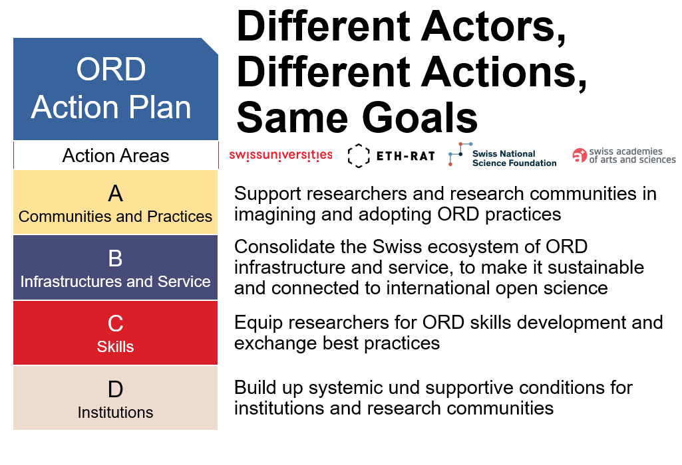
ORD Action Plan

Slide 10
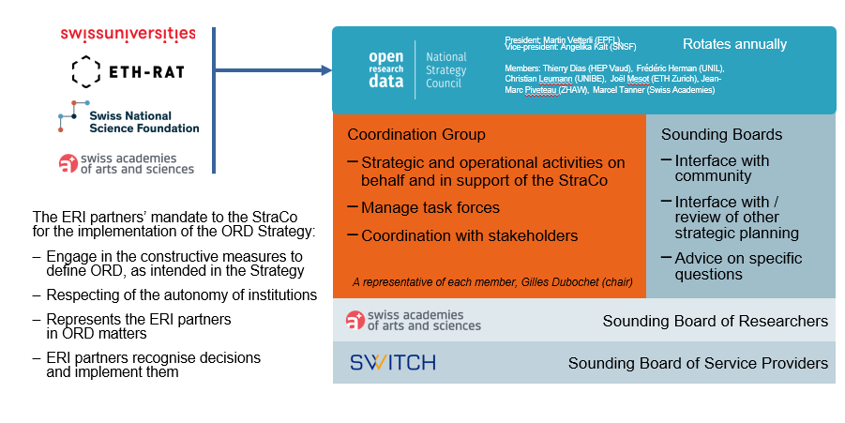
New Governance model: The STRATCO
Notes:
Key messages / Presentation Notes
Presidency rotates yearly
ERI partners mandate means the StraCo represents them when it comes to ORD topic
includes convergence and coordination of ORD infrastructure
Coordination Group is operational arm of the StraCo
2 sounding boards, with a “facilitating organisation” who takes charge of it. Principle agreement with Switch for them to coordinate the major service providers
Creating this structure is a 1st big outcome of the StraCo
Background
Members are selected by the ERI partners. 2 from the ETH Board, 1 each from SNSF and A+, 2 each from the chambers HEU and HES, and 1 from chambre HEP
Expected composition of SB Service Providers: SWITCH, SDSC, FORS and DaSCH (one seat together), SPHN, and SIB. In addition, SLiNER (AKORD), and NiCT to represent the distributed service in the institutions (libraries and IT services respectively).

Slide 11
Results
Open Access
New Governance Structure of StratCo (Cluster Approach, strong focus and inclusion of researcher)
There is a general perception that EOSC is becoming more and more important in CH (CH organisations are asking themselves how they should adapt to EOSC).
Open Science becomes more and more important in CH.
Impetus to adopt FAIR principles
Formation of networks and vessels for exchange (EOSC TFses, Nodes, FAIR Metadata, etc.).
Notes:
ORD Strategy very young: The structure of the StraCo itself, as an Einfache Gesellschaft to which the partner-actors delegate their ORD responsibility, which is quite original in the Swiss context; alle abholt
The Cluster Approach. We’re still waiting for the results (the blueprint) of our Task Force Health and Life Sciences, but have already gotten signals that our approach to landscape analysis is addressing some of the problems previously encountered in this type of analysis (notably by looking at infrastructures through the lens of the cluster and using their interactions as a structuring elements, rather than using infrastructures as units of analysis); grosser Foklus auch Forschende

Slide 12
Objectives of CH ORD Strategy & EOSC
ORD Goals
EOSC Goals
Obj. A: Support researchers and research communities in imagining and adopting ORD practices
Obj. B: Development, promotion, and maintenance of financially sustainable basic infrastructures and services for all researchers
Obj. C: Equipping researchers for ORD-skills development and exchange of best practices
Obj. D: Building up systemic und supportive conditions for institutions and research communities
Obj. 1: Ensure that Open Science practices and skills are rewarded and taught, becoming the ‘new normal’
Obj. 2: Enable the definition of standards, and the development of tools and services, to allow researchers to find, access, reuse and combine results
Obj. 3: Establish a sustainable and federated infrastructure enabling open sharing of scientific results

Slide 13
Status Quo and future task and plan
Stronger alignment of ORD and EOSC activities in CH => ORD and EOSC are very complimentary; ORD focuses strongly also on incentives and rewards for researchers, career advancement, ethics and dual use problems, while EOSC focuses also strongly on the infrastructure and provider perspective
EOSC CH Nodes
Continuous support and motivation for CH actors in EOSC and Open Science Policies in General
HEU association
Notes:
Stronger alignment ORD and EOSC activities in CH, aber auch sehr complimentär => vl in hinsicht auf service providers/ user perspective (Finally, Action Area D focuses on incentives and rewards for researchers and calls for making ORD a prerequisite for funding and career advancement (Measure D1)/ D2 wird auch wichtiger.. Sehr gut komplemtär..

Slide 14
Thank you very much!
Anna Fill, Dr.
Scientific Advisor, International Research and Innovation Programmes
Einsteinstrasse 2, 3003 Bern, Switzerland
Tel. +41 58 485 08 83
Mobile +41 79 155 71 99
anna.fill@sbfi.admin.ch
State Secretariat for Education, Research and Innovation SERI
International Programmes and Organisations
Unit: International Research and Innovation Programmes

