Slide 1
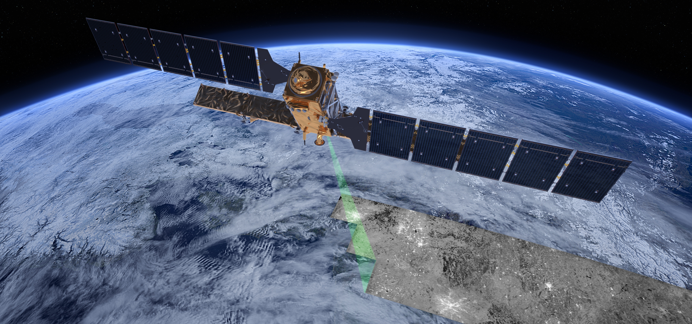


C-SCALE
Enabling Copernicus Big Data Analytics through EOSC
Charis Chatzikyriakou (EODC) and the C-SCALE Team
The EOSC Lustrum | 19 October 2023 | Vienna, Austria
©ESA/ATG medialab
This project has received funding from the European Union’s Horizon 2020 research and innovation programme under grant agreement No 101017529.

Slide 2
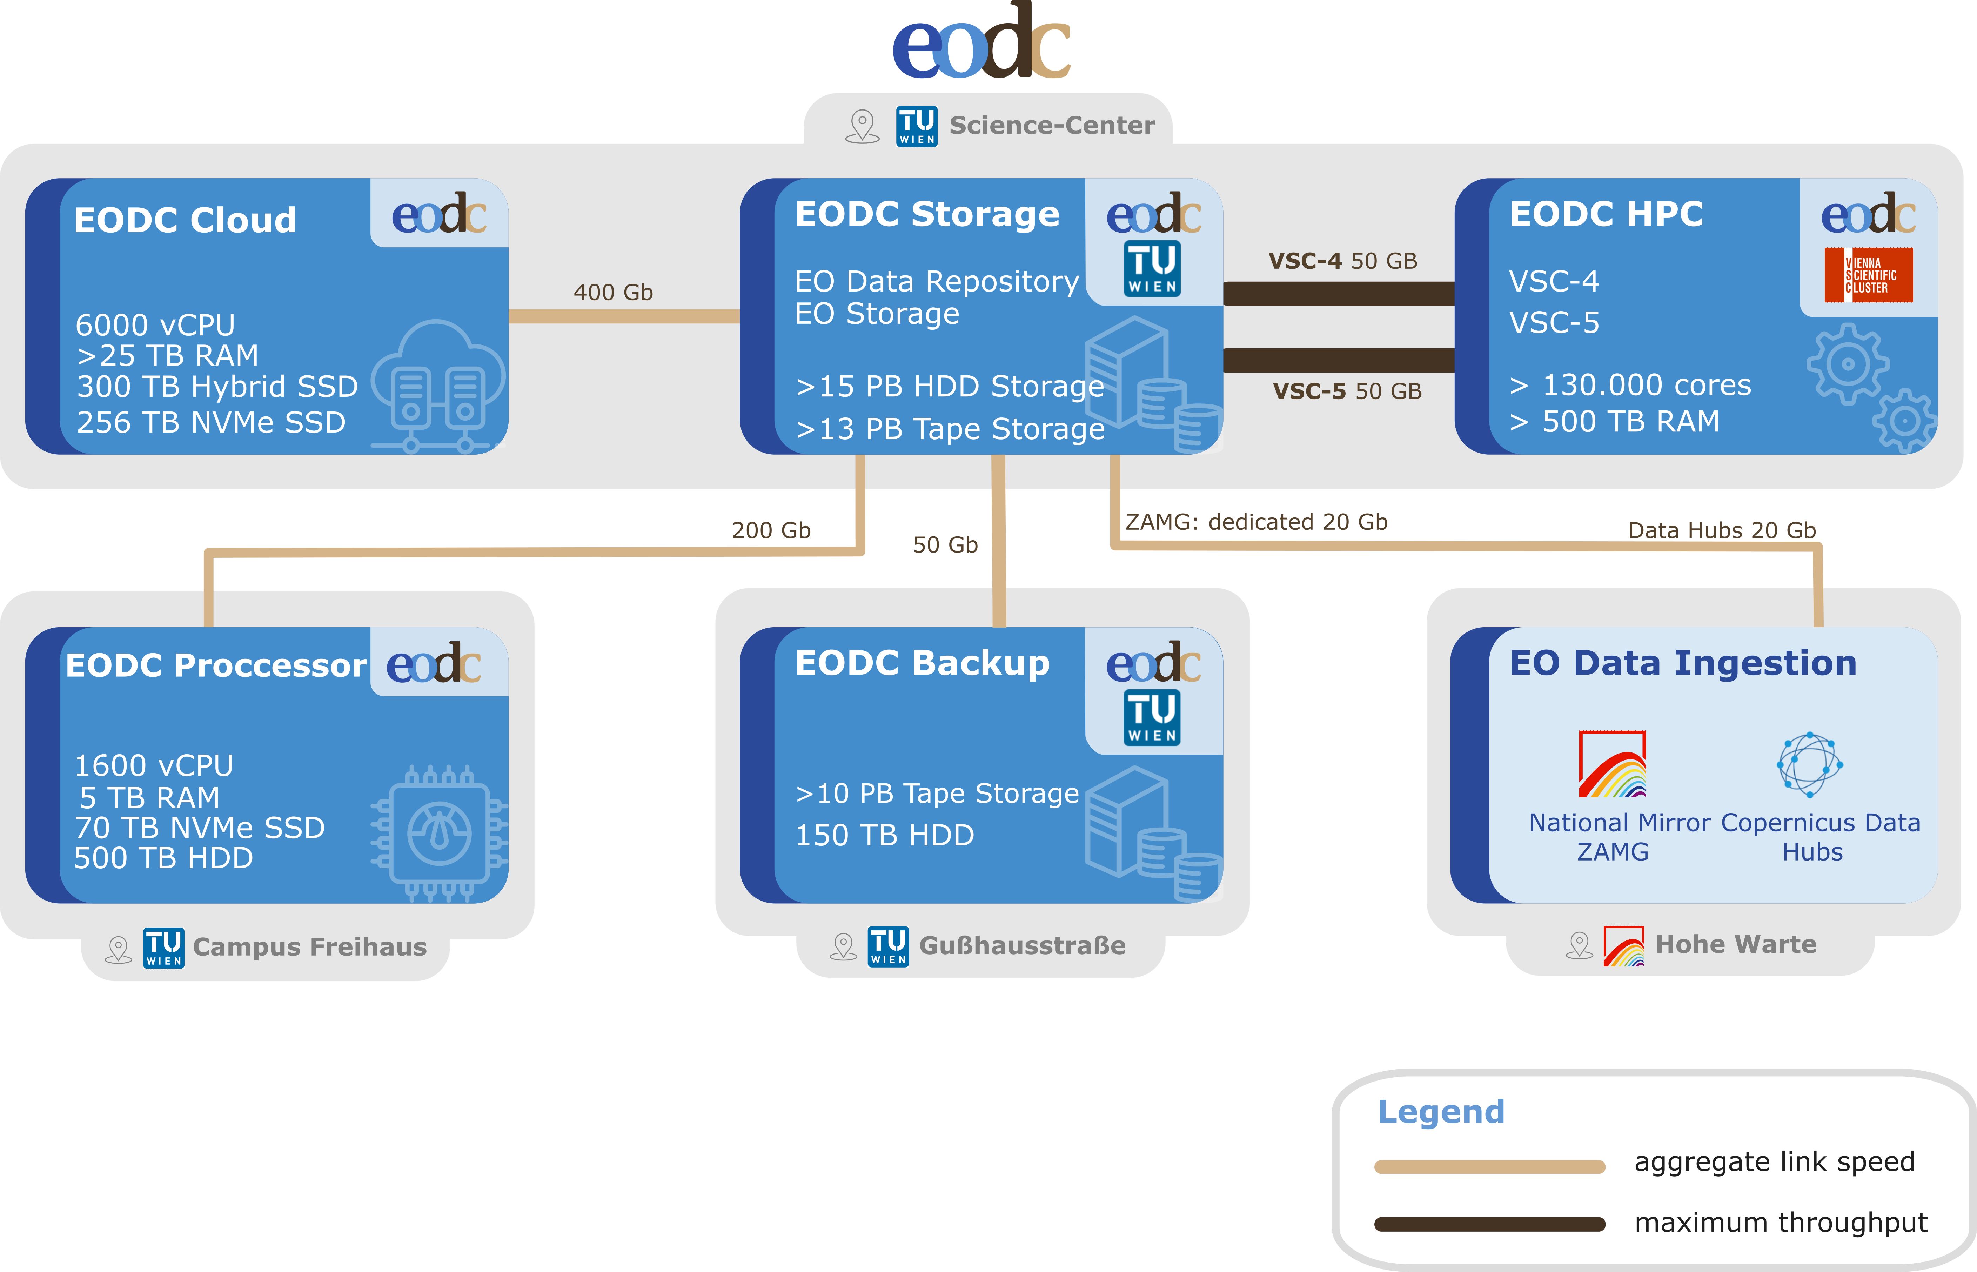


EODC – Collaboration for Earth Observation
SME following a public-private-partnership (PPP) model, founded in 2014.
Collaborate with our shareholders and multi-national partners from science, the public and private sectors to foster the use of Earth observation data.

Slide 3
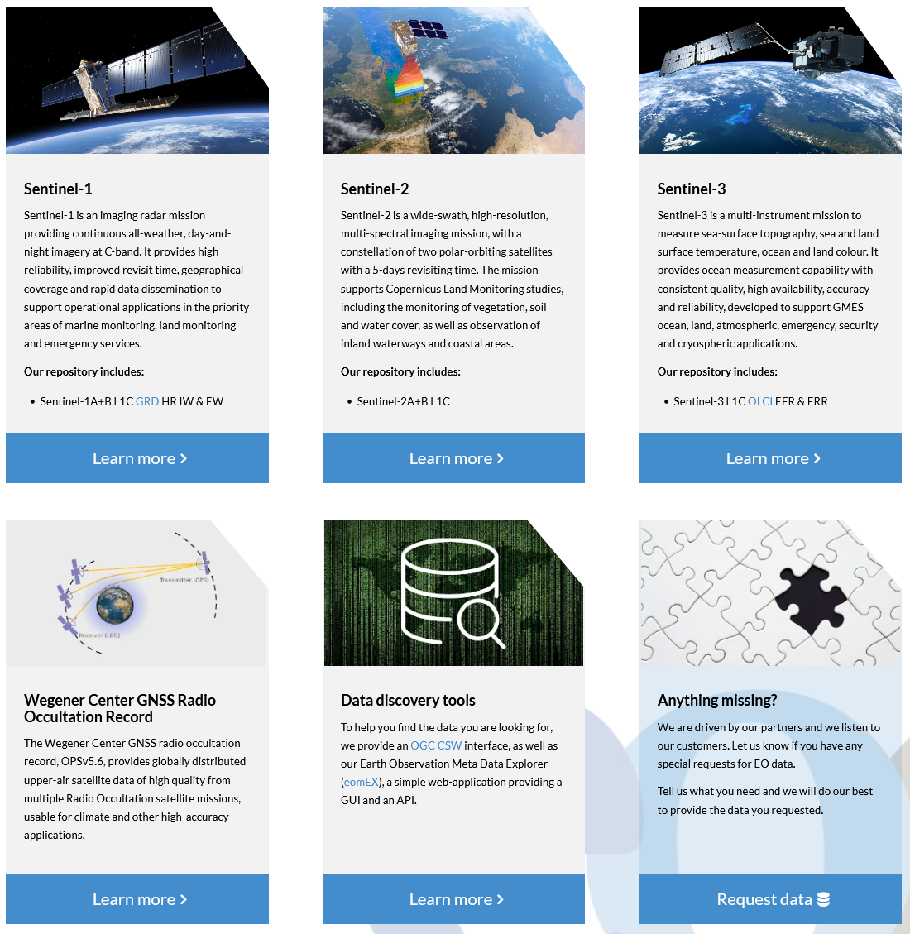
EODC EO Data
Strong focus on timeliness
Additional data sets
  ERA-5 data
  Historic missions available
  Austrian DEM, Orthophotos, LIDAR
  On request
ARD offer
  Global S-1 backscatter data available
  S-2 L2A processing
EODC STAC Catalogue

Slide 4












EODC’s role for Austria’s Copernicus stakeholders
Research
Models & Algorithms
Domain-Specific Expertise
Validation & Verification
Innovation & Development
Private Sector
Requirements
Collaboration & partnership with other sectors
Commercial Applications
Technology
Public Sector
Requirements
Data sharing
Policy & Regulation
Funding & Support
EO Data Management & Storage
EO Compute (scalable Processing )
Experts for Integration, Security, Interoperability & Performance

Slide 5
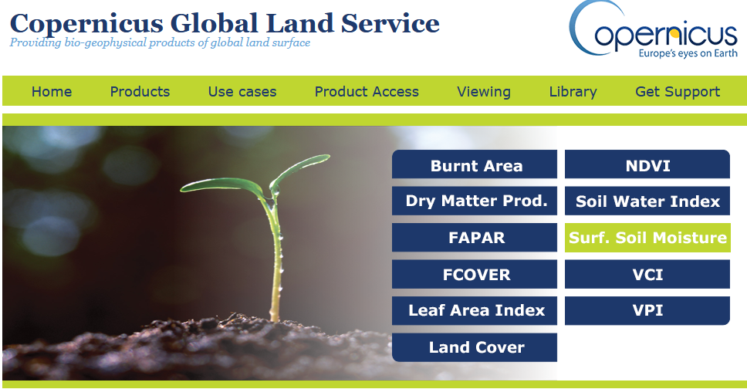
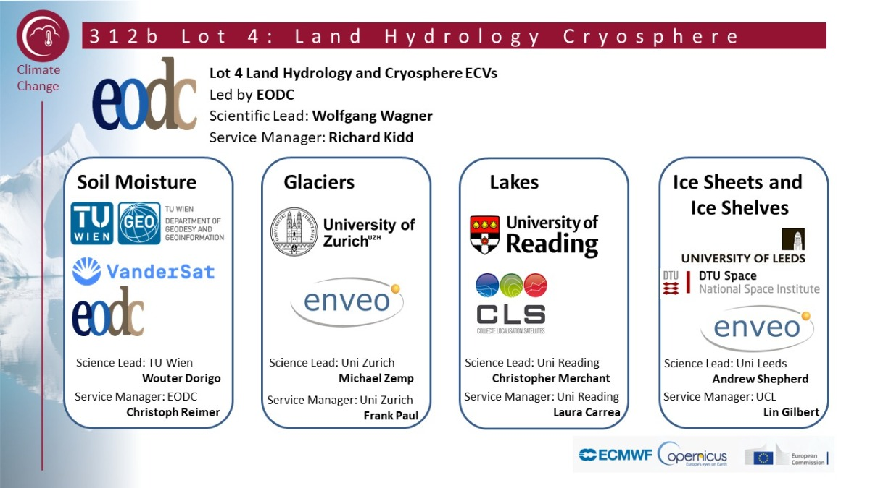









EODC’s role in Copernicus Operational Services
Copernicus Global Land (C-GLOPS)
https://land.copernicus.eu/global
Copernicus Climate Change Service (C3S), Lot 4: Land hydrology and cryosphere
https://climate.copernicus.eu/
CEM: Global Flood Monitoring service
https://www.globalfloods.eu/

Slide 6





EODC’s role in the European landscape
openEO platform (https://openeo.cloud)
Data Hub Relay: ESA Missions (https://datahub.eodc.eu/)
interTwin - Co-designing and prototyping an interdisciplinary Digital Twin Engine (https://www.intertwin.eu/)
GREAT - Green Deal Data Space (https://www.greatproject.eu/)
C-SCALE - Copernicus – eoSC AnaLytics Engine (https://c-scale.eu/)

Slide 7
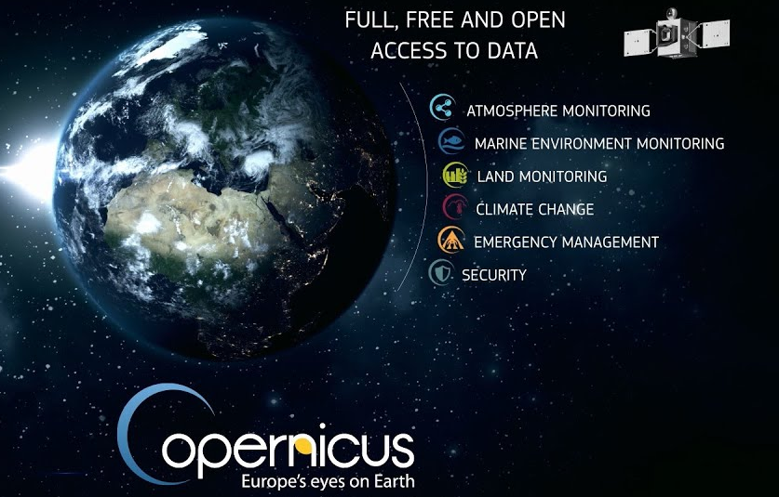
Copernicus programme
The Copernicus programme has established itself globally as the predominant global spatial data provider.
It aims to contribute significantly to the vision of a digital copy of our Earth, i.e. a digital twin of the earth, supporting current EC goals within the Europe 2020 strategy, the Green Deal and its related Destination Earth initiative.
7

Slide 8
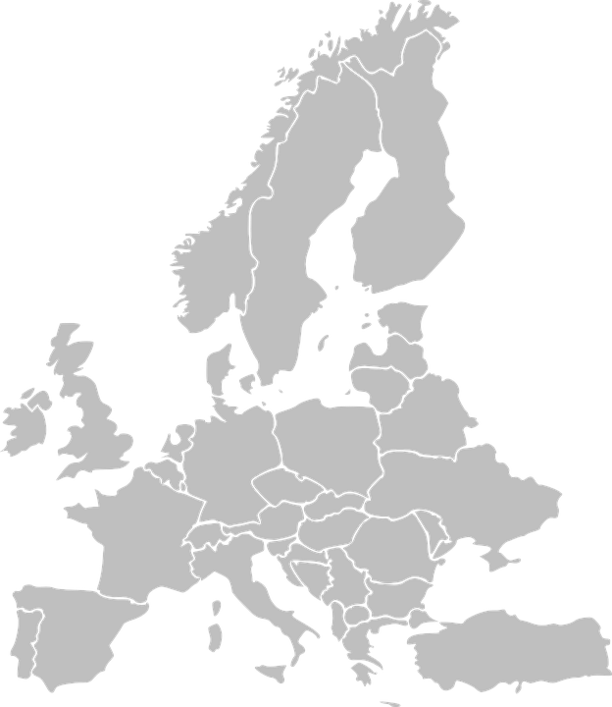












The C-SCALE Project
Europe lacks an integrated compute and storage infrastructure for the exploitation of Copernicus datasets in scientific and applied applications.
C-SCALE responds to that challenge by enhancing the EOSC Portal with pan-European federated data and computing infrastructure services for Copernicus.
C-SCALE: Copernicus - eoSC AnaLytics Engine
Project duration: Jan 2021 – September 2023
Budget: ~ 2 million Euros
Consortium of 11 partners with pan-European coverage

Slide 9

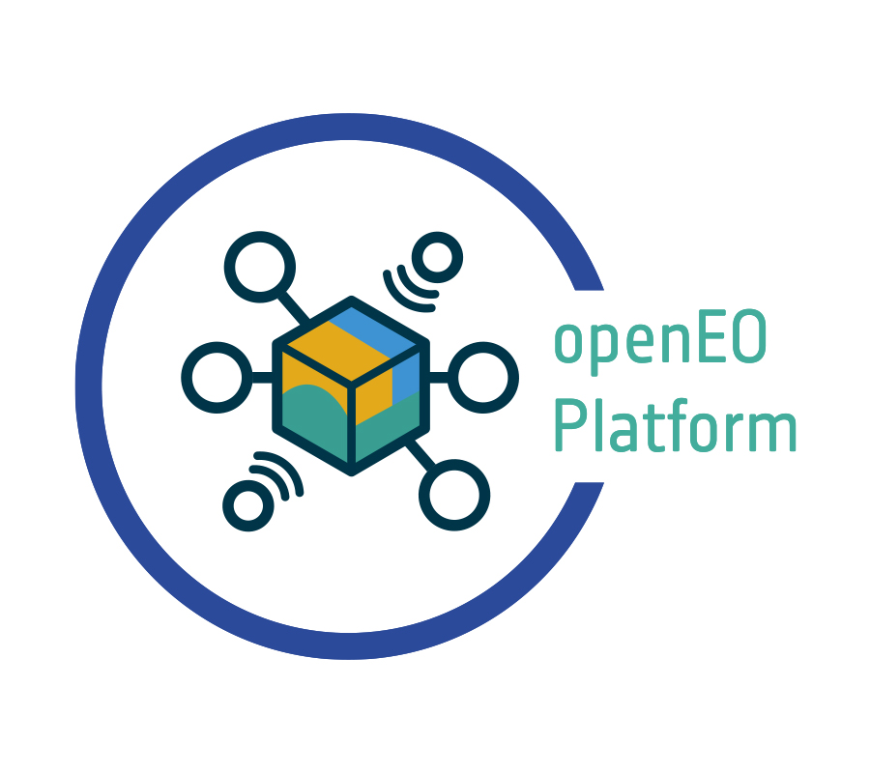



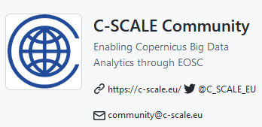
Project Objectives and Results
Objectives
O1: Scale-up the EOSC Portal integrating pan-European computing and data resources for Copernicus
O2: Federate Copernicus resources with EOSC computing and storage providers
O3: Piloting the provision of a distributed online Sentinel long-term archive in EOSC
O4: Co-design of the federation with relevant scientific communities across Europe
Main Results:
FedEarthData
openEO Platform
Earth Observation Metadata Query Service
Workflow solutions
C-SCALE Community
9

Slide 10







FedEarthData
FedEarthData: federation of Earth observation data archives and computing resource providers, enabling execution of Earth observation processing workflows with seamless access to data
Batch and interactive processing
openEO / Notebooks
HTC/HPC resources
Cloud Resources
PaaS Orchestrator
HPC/HTC
Container orchestrator
IaaS Cloud
Authentication and authorisation services
Identity management infrastructure services
Monitoring
Accounting
Virtual Machine or container image management and redistribution
SRAM
jobs
Local
storage
cont
Local
Storage
VM
Local
Storage
C-SCALE Software repository
EGI Check-In
C-SCALE Data Federation
10

Slide 11

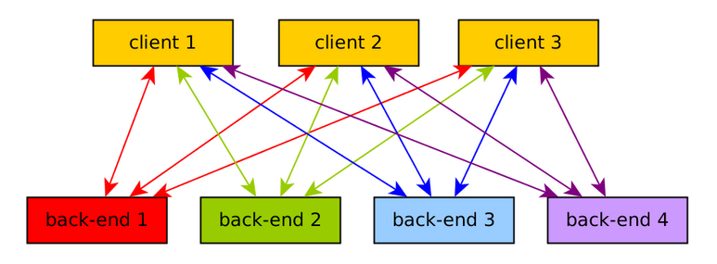
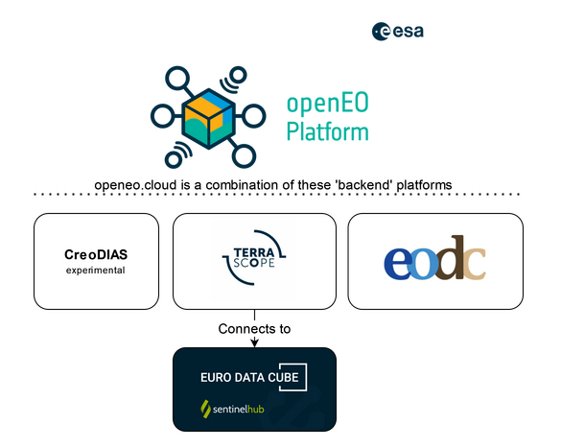
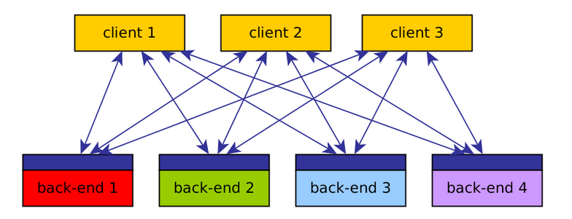
openEO Platform
Situation before openEO:
openEO Platform:
Client 1
Client 2
Client 3
openEO API:
Clients: Python, R, Javascript
Web Editor
JupyterLab
11

Slide 12
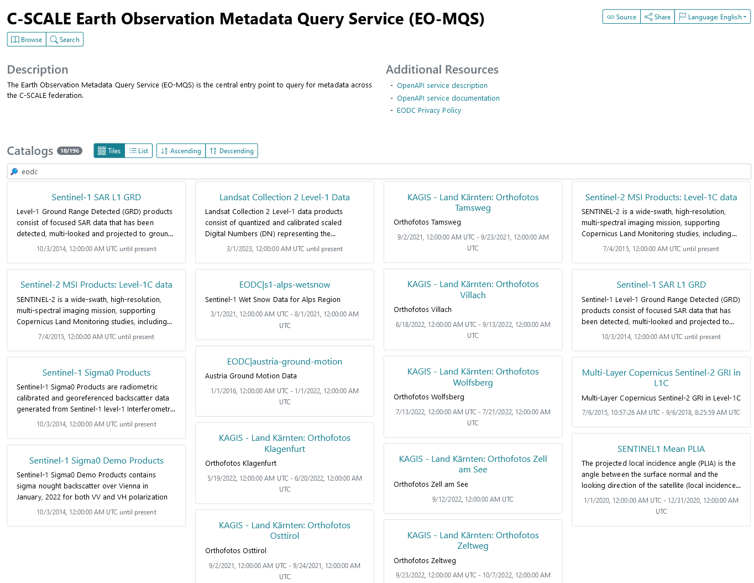
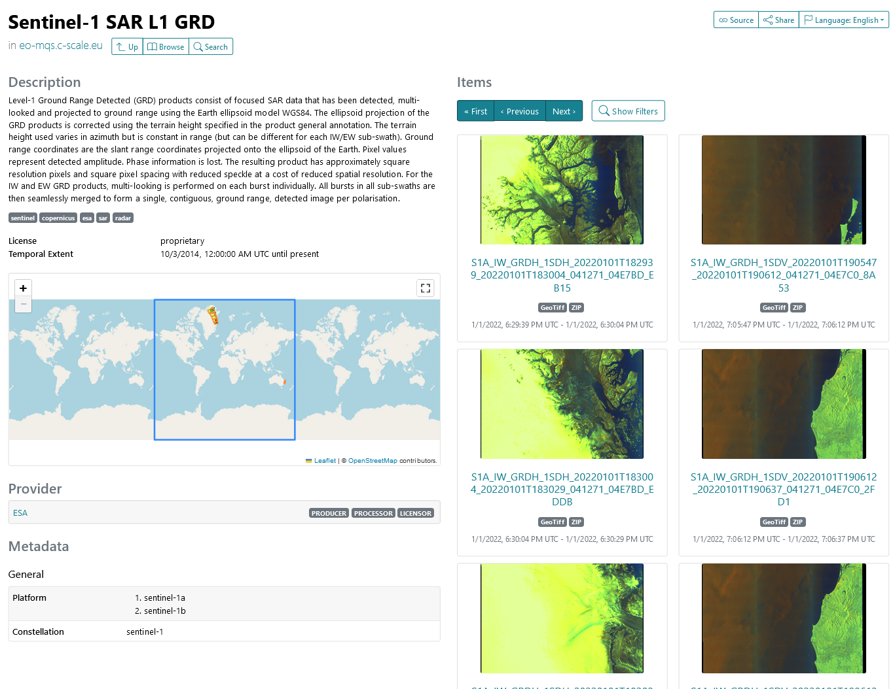
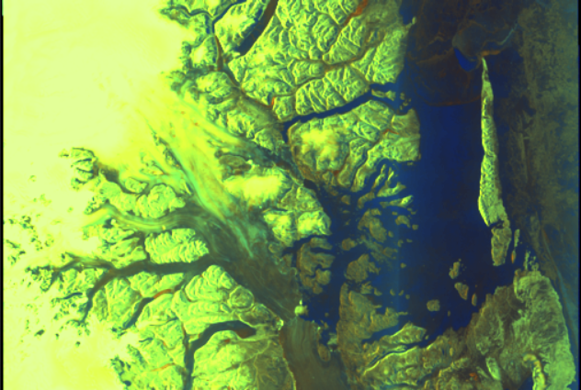
Earth Observation Metadata Query Service
Earth Observation data discovery service arching over FedEarthData member providers
Data providers already know where their data are
        Bring their discovery interfaces under a common one
  single point
  shared protocol
Spatio-Temporal Asset Catalogue (STAC) interface to enable queries across the federation
EO-MQS is a query broker and aggregator, it is
not yet another metadata database.
Focus and data retention policies at member sites - avoiding polling resources irrelevant to the given query
12

Slide 13

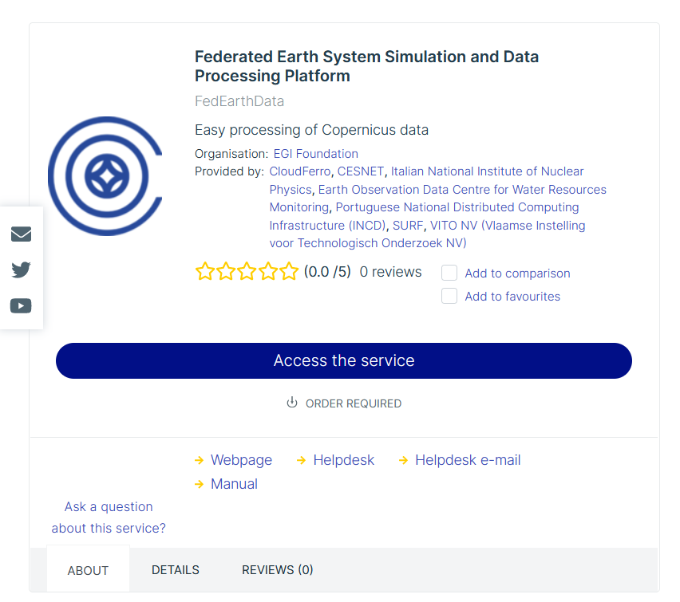
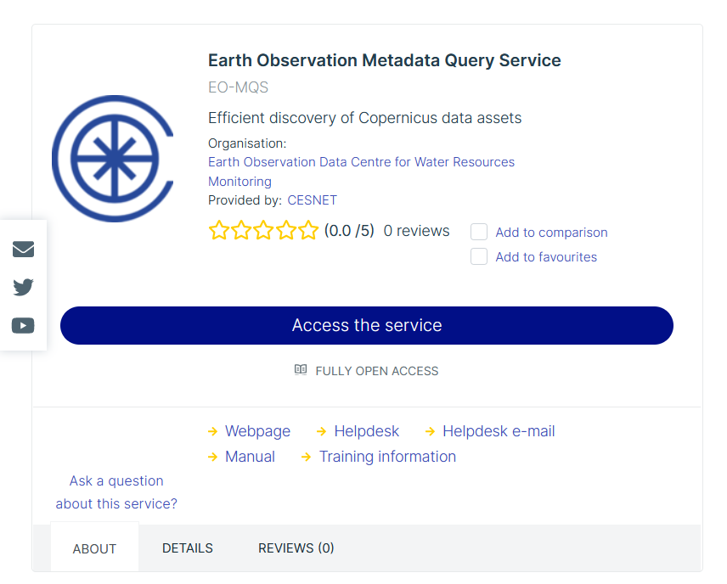
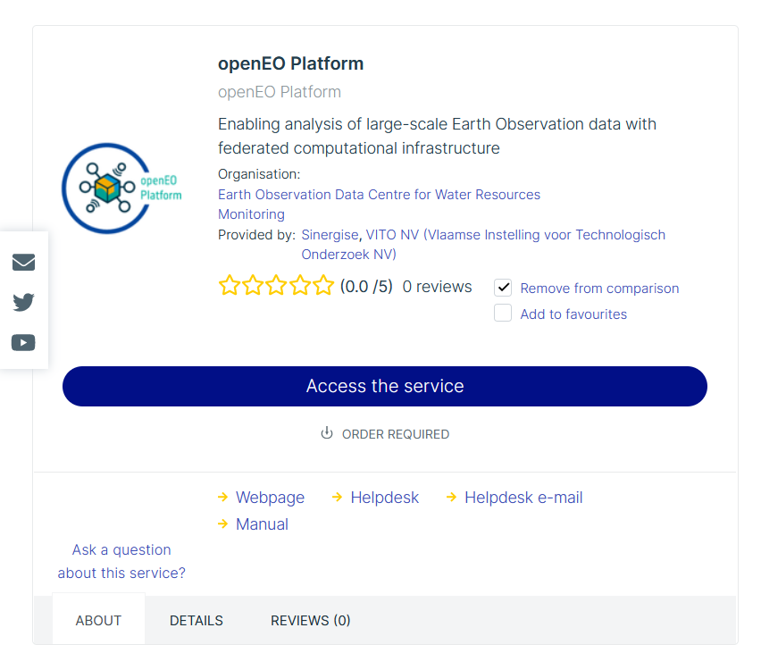
How to access the C-SCALE services
Main exploitation paths:
EOSC Marketplace
C-SCALE website
openEO Platform website
OPERATIONAL
OPERATIONAL
OPERATIONAL
https://marketplace.eosc-portal.eu/services/eosc.egi-fed.fedearthdata
https://marketplace.eosc-portal.eu/services/eosc.eodc.eo-mqs
https://marketplace.eosc-portal.eu/services/openeo-platform/
13

Slide 14
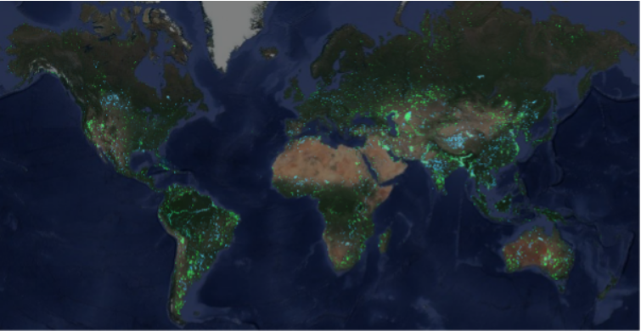
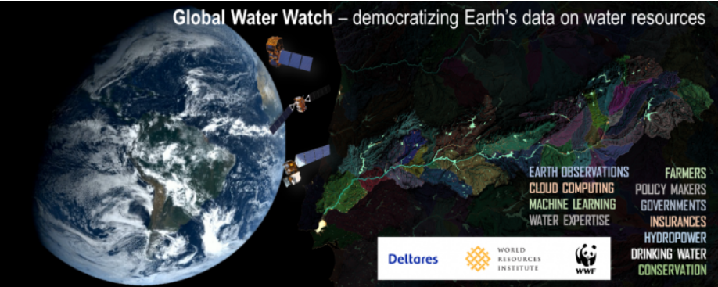


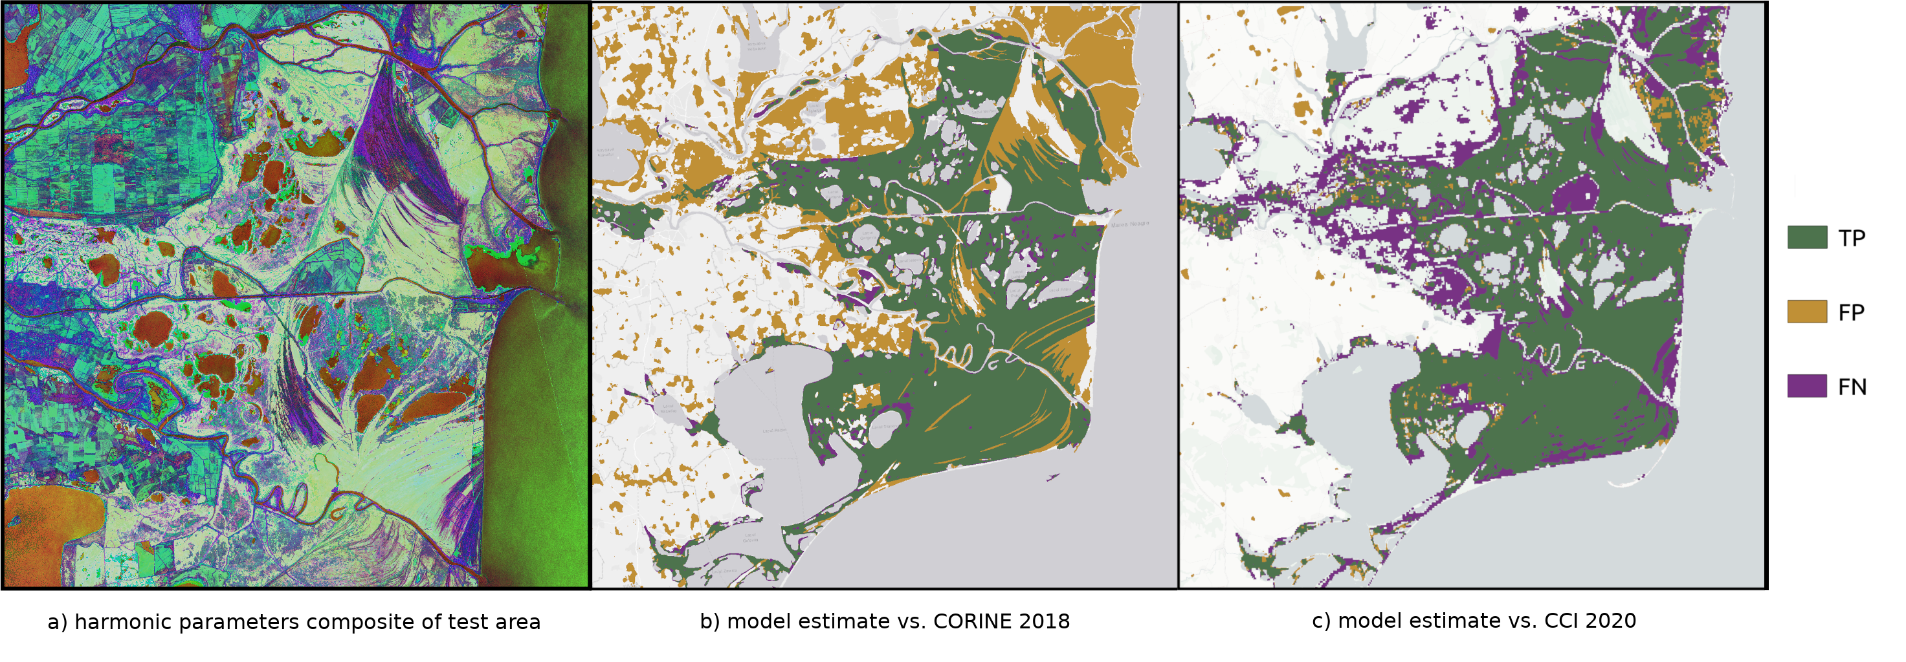

C-SCALE workflow solutions
Workflows for Copernicus data processing: easy deployment of workflows supporting monitoring, modelling and forecasting of the Earth system
Provided by C-SCALE Use Cases
Templates and reusable components for users to build their own applications on FedEarthData
Aquamonitor using OpenEO on C-SCALE
Global Water Watch using OpenEO on C-SCALE
Link
Link
Link
Link
Automated monthly river forecasts using Wflow
Link
Link
Coastal hydrodynamic and water quality modelling using Delft3D FM
Link
Link
ML-Pipeline for Wetland Monitoring
Link
14

Slide 15
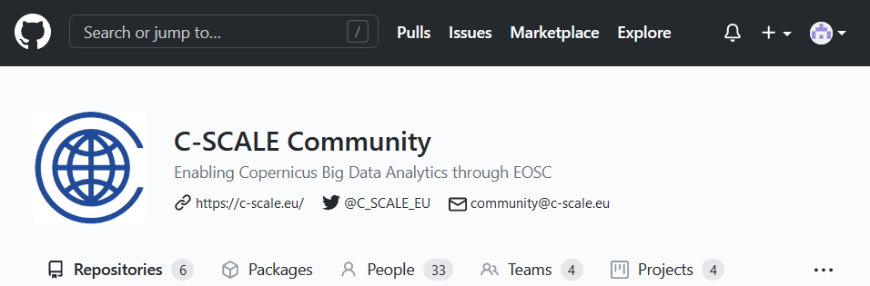

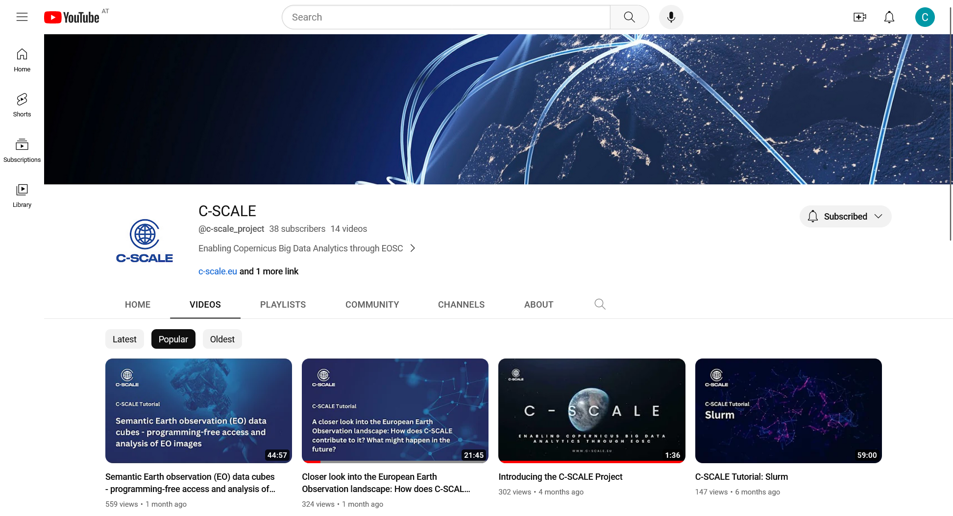

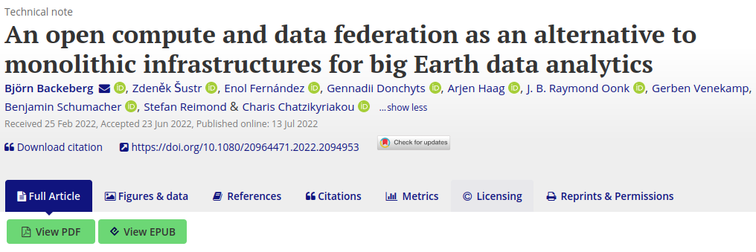
User engagement
User forum and functional co-design
C-SCALE community: https://github.com/c-scale-community/discussions
encourages advanced users to become active participants in the development of the future C-SCALE services
mechanism to engage with the national and international organisations invested in Copernicus services
C-SCALE documentation, training and support
https://wiki.c-scale.eu/C-SCALE
https://www.youtube.com/@c-scale_project
https://doi.org/10.1080/20964471.2022.2094953
15

Slide 16
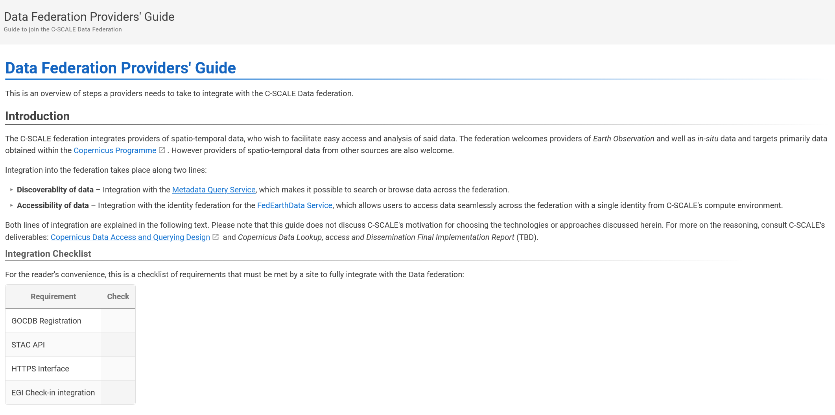
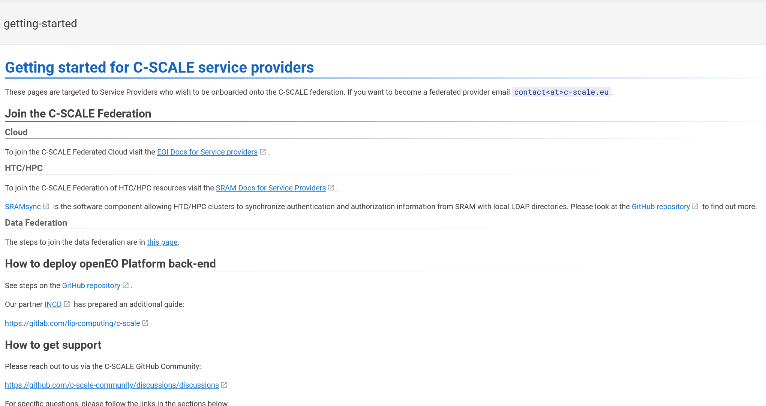
Provider onboarding
C-SCALE aims to expand its Compute and Data federation with new service providers!
Well-defined guidelines to join the federation
  Technical integration
      configure your system to allow federated identity
      register in catalogues
  Non-technical integration: contacts, AUP, Privacy Policies…
Support is provided through the whole process
If you interested, get in contact with us!
16

Slide 17




contact@c-scale.eu
Charis Chatzikyriakou (EODC) and the C-SCALE Team
https://c-scale.eu
@C_SCALE_EU
https://www.youtube.com/@c-scale_project
The EOSC Lustrum | 19 October 2023 | Vienna, Austria
https://zenodo.org/communities/c-scale

