Slide 1
The Croatian Open Science Cloud Initiative (HR-OOZ)
Draženko Celjak
Head of data management department,
SRCE - University of Zagreb University Computing Centre
www.srce.unizg.hr/en

Slide 2
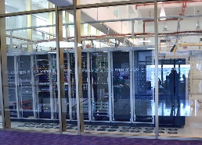
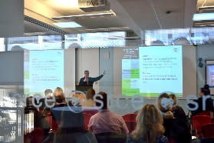
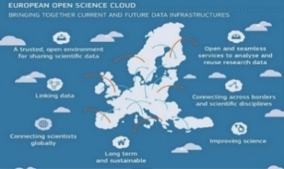

University of Zagreb University Computing Centre (SRCE)
… Builds national
e-infrastructure,
from data centres, through network, computer
and storage resources, all the way to information services
~ 170 employees
~ 30 public services
11 organizational units
5 data centres (2x Zagreb, 1x Split, 1x Rijeka, 1x Osijek)
3 locations in Zagreb
Founded in April 1971
… Provides digital services, education of users and advanced user support
… Builds bridges to international infrastructures and initiative
… Is a synonym for a digital transformation of science and higher education system

Slide 3




SRCE & national infrastuctures
AAI@EduHr
National eduroam operator
Croatian scientific and educational cloud (HR-ZOO)
National
RDA node
Support
centres for information systems ISVU, ISSP,
CroRIS, ISeVO
National Competence Centre for
HPC
Croatian
Open Science Cloud
(HR-OOZ)
National and university
e-learning centre
EDIH …

Slide 4


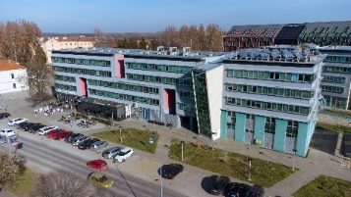
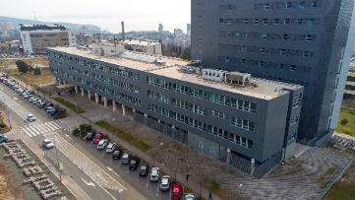

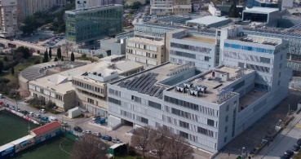
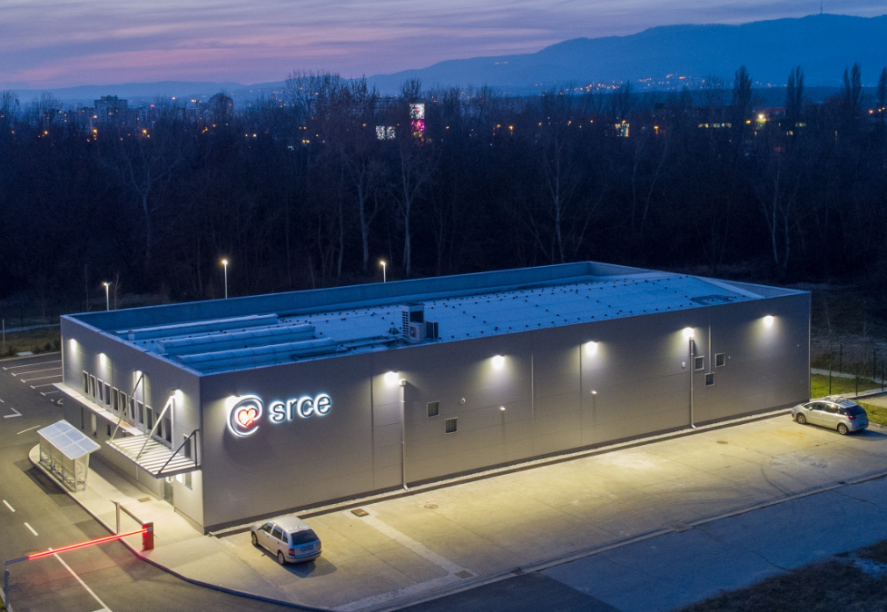

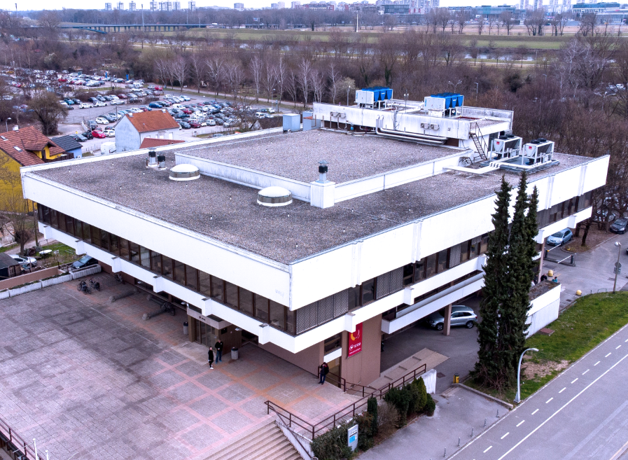

Croatian Scientific and Educational Cloud (HR-ZOO)
DATA CENTRES
HR-ZOO
ZG2
HR-ZOO
ZG1
HR-ZOO
OS
HR-ZOO
RI
Coordinator: SRCE
Reference: KK.01.1.1.08.0001
Project value: 25 mil. EUR
EU contribution: 21 mil. EUR
Implementation: 1.7.2017 - 1.5.2023
https://www.srce.unizg.hr/hr-zoo/en
HR-ZOO
ST
Ivan Supek
Andrija Štampar
HR-ZOO
Project is co-funded by European Union from European Regional Development Fund
Notes:
HR-ZOO represents a new generation of national e-infrastructure consisting of advanced computing and storage resources located in five data centres in four university cities, along with several associated digital services. Data centres have been connected with network capacities of 100 Gbit/s (upgrade the backbone of the national academic and research network CARNET). By connecting to the GEANT PoP, the national e-infrastructure connects to e-infrastructures in Europe and the world.

Slide 5

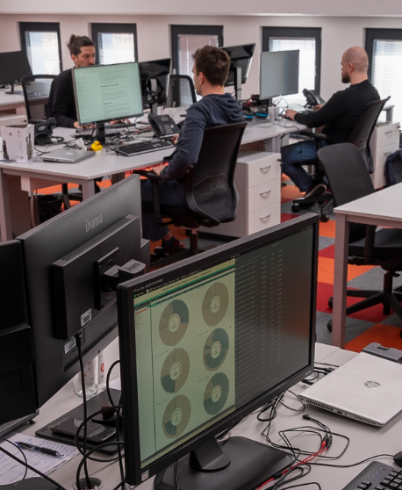


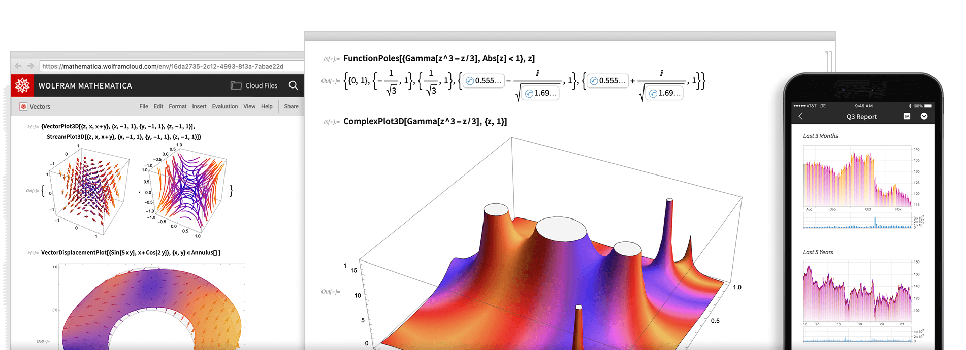

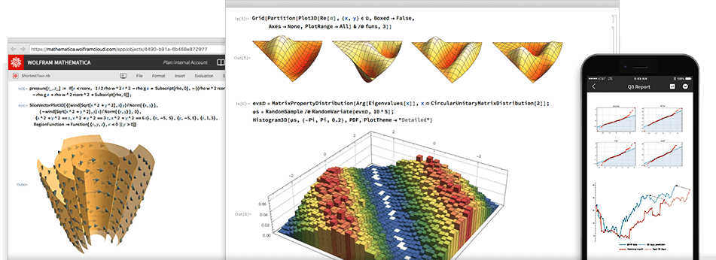
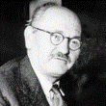

New and improved services within project HR-ZOO
ADVANCE COMPUTING
VIRTUAL DATA CENTRES
SPECIALIZED SUPPORT
SCIENTIFIC SOFTWARE
Ivan Supek
Andrija Štampar
Faust Vrančić
Notes:
„Supek” is supercomputer based on HPE Cray technology and consists of 8384 processor cores, 81 GPUs, and 32 TB of working memory providing a power of 1.25 PFLOPS, which makes it the first petascale supercomputer in Croatia. It is located in the area of the newly built data centre at University Campus Borongaj in Zagreb.
Advanced cloud computing "Vrančić" is designed for scientists in need of a flexible, elastic, and versatile computing resource capable of meeting the diverse requirements of various scientific fields. Consist of 11.000 core processors, 16 GPUs, 3 PB of high performance storage.
„Štampar” - Virtual Data Centres – based on cloud computing with 1800 redundant virtual servers in high availability mode, 10 PB of disk space.

Slide 6





Croatian Competence Centre for HPC (HR HPC CC)
HR HPC CC established within the project EuroCC as part of a network of national competence centres for HPC.
ONE-STOP-SHOP FOR HPC
The Croatian Competence Centre for HPC is a place where users from the academic and scientific community, industry, and public administration get support in the application of the national and European infrastructure of High Performance Computing (HPC) in their work.
Services to and Interaction with Academia and Public Administration
Collaboration
Education and skills development in HPC/HPDA/AI
Services to and Interaction with Industry
Service Portfolio and Competence Management
Project EuroCC 2 is currently underway and will further improve the centre's services and competencies
https://www.hpc-cc.hr/
Notes:
EuroHPC JU budget 2021-2027 ~ 7 billion. €
The two main goals of EuroHPC JU are:
Development of pan-European infrastructure for supercomputing: procurement and implementation of EU supercomputers
Supporting research and innovation activities: developing a European ecosystem for supercomputing technologies

Slide 7






Data services and Open Science
SRCE’s services supporting Open Science
Education and networking with the European and global research community
National Open Science Cloud
Croatian Open Science Cloud
(HR-OOZ) Initiative
National Open Science Plan
HR-OOZ Catalogue of services, tools and resources

Slide 8


Data infrastructure & services for Open Science
CROATIAN OA JOURNALS
Since February 2006
536 scientific & professional journals (406 active)
285.000 + OA articles
65.000+ visits daily
PRESERVATION & DISEMINATION
Digital archives and repositories
16 types of digital objects
171 digital repositories of research & HE institutions
224.000 digital objects
(TEMPORARY)
STORAGE & SHARING SERVICE
570+ researchers and lecturers
200 GB (default)

Slide 9

Chronology
Open Science Policy of
the University of Rijeka
Strategy of Education,
Science &Technology
Declaration on the Application
of Open Science Principles
at the University of Zadar
Croatian Open
Access Declaration
Research & Innovation
Infrastructure
Development Plan
HR-ZOO
HR-OOZ
CLARIN
ERIC
DARIAH
ERIC
CESSDA /
CROSSDA
EATRIS
ERIC
CRO GRID
C-ERIC
(DONES)
CROSBI
HRČAK
ARA
DABAR
RDA NODE
CroRIS
CARNET
Isabella
CRO NGI
SRCE
Cloud
HTC
Cloud
1992
2003
2006
2012
2013
2014
2015
2016
2018
2019
2023
1997
2002
2007
2020
2024

Slide 10



Preparation for EOSC
Project NI4OS-Europe
National Initiatives for Open Science in Europe
September 2019 – February 2023
Supported the development and inclusion of the national Open Science Cloud initiatives in 15 Member States and Associated Countries
Instilled within the community the EOSC philosophy and FAIR principles for data
Provided technical and policy support for
on-boarding of service providers into EOSC
Collaboration with complementary EOSC projects
  EOSC-Pillar
  EOSC-synergy
  EXPANDS
  EOSC-Nordic
  EOSCSecretariat.eu
SRCE, as a mandated organization of the Republic of Croatia, became a full member of the EOSC association in December 2020

Slide 11
Croatian Open Science Cloud (HR-OOZ) Initiative
Role of HR-OOZ
Indicators
National
  gathering of all significant stakeholders
  support alignment of national policies and practices for Responsible Research and Innovation, Open Science and FAIR data with the EOSC
International
  coordinates the participation of organizations in accordance with pan-European initiatives such as EOSC, HPC, PRACE, EGI, etc.
Organisation of the HR-OOZ
Infrastructure & Services
Training & Skills
Sustainability and international collaboration
1.
1.
2.
2.
3.
3.
4.
4.
The EOSC Lustrum; 5 years of EOSC developments – All about everything
19th October 2023

Slide 12
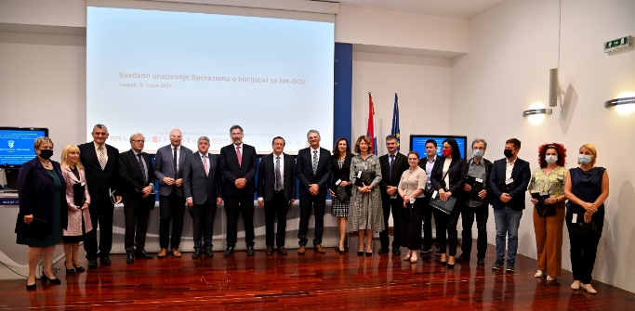





















Croatian Open Science Cloud (HR-OOZ) Initiative
GOALS
National Open Science
Cloud (HR-OOZ)
National Open Science Plan
Memorandum of Understanding, September 2021
https://www.srce.unizg.hr/en/hr-ooz

Slide 13
Organisation of the HR-OOZ Initiative
HR-OOZ Initiative
stakeholders in the Croatian science and higher education system who are working together to achieve goals related to open science in Croatia
The Council of the HR-OOZ Initiative
the coordinating body that manages the Initiative which is composed of all signatories of the MoU
Task Forces
achieving individual goals or groups of goals of the Initiative
TF for drafting the proposal of the national plan and policies for open science
TF for defining the structure and principles of HR-OOZ

Slide 14


HR-OOZ Infrastructure & Services
Analysis of existing research infrastructures, resources, services & e-infrastructures
Building HR-OOZ - the national infrastructure dedicated to open science
Structure and principles of HR-OOZ
  HR-ZOO regulation (rulebook)
  Inclusion criteria (for on boarding services and recourses into HR-OOZ)
  Catalogue of HR-OOZ services and resources
HR-OOZ
CroRIS
HR-ZOO
HR HPC CC

Slide 15



Croatian Research Information System – CroRIS
An element of project Scientific and Technological Foresight lead by Ministry of Science and Education of the Republic of Croatia
National Research Information System (national CRIS)
Information and processes about institutions, researches, projects, publications, equipment, patents, services, events and much more
Integration with many national systems and international platforms, such as ORCID, OpenAire, WoS, Scopus
Promote open science
Provide information reliability
Ensures openness and interoperability
Support decision making
https://www.croris.hr/
Project is co-funded by European Union from European Regional Development Fund
Notes:
Currently CroRIS ha: +35000 users, +800 000 publications, 129 HEI, +8700 projects

Slide 16









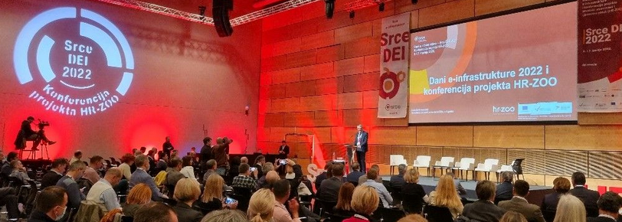
CroRIS – as Catalogue of HR-OOZ services and resources
https://www.croris.hr/
Projects
Journals
Funding
Scientists
Publications
Scientific institutions
Equipment and services
HE Institutions
Citations
Scientific disciplines
Events
Patents and products

Slide 17
Training & Skills
Providing education for researchers
  the necessary competences and skills to apply open science practices
  educational materials, handbooks & courses
Development of the national curriculum
& specialized trainings for:
  Data steward
  Data curator
Research data management &
Data management plan (DMP)
PLAN
REUSE
COLLECT
RESEARCH
DATA LIFE
CYCLE
Be
F
A
I
R
SHARE
PROCESS
FINDABLE
ACCESSIBLE
INTER-OPERABLE
REUSABLE
COLLECTIVE (BENEFIT)
AUTHORITY TO CONTROL
RESPONSIBILITY
ETHICS
PRESERVE
ANALYZE
and
C
A
R
E

Slide 18
EOSC National Tripartite Event in Croatia
E-infrastructure Days - SRCE DEI 2023, 30th March 2023
organised by SRCE, with an attendance of more than 100 participants from the A&R community,
public presentation of the Croatian Plan for Open Science, proposal prepared within the framework of the Croatian Open Science Cloud Initiative (HR-OOZ),
panel discussion on the topic "What Needs to Happen Next in Croatia?" with participation of prominent experts from A&R community reached next conclusions:
  Researchers need a quality system and various forms of support for open science,
  The adjustment of evaluation system of institutions and projects implementing open science values and principles
  Rewards and incentives for researchers applying open science principles (recognition for their efforts).

Slide 19
Croatian Open Science Plan – main goals
The Ministry of Science and Education is currently in proces of adoption
advance the understanding of the meaning, conception, advantages and practicing of open science in the academic and scientific community,
promote basic values and principles of open science such as responsibility, scientific integrity, ethics, research quality, research transparency, research reproducibility, sharing, cooperation, openness, equality, inclusiveness, diversity, flexibility, sustainability, etc.,
ensure preconditions (and remove obstacles) and create organizational, legal, financial and technical frameworks for the effective application of the principles and practices of open science in the science and higher education system in Croatia,
promote and apply a new system of evaluation and assessment in science and higher education, by using of adequate, new indicators of performance, quality and efficiency of research and education, introduce new indicators and criteria for evaluating institutions, rewarding and advancing teachers and researchers that will fully recognize the contributions to open science,
encourage and provide OA to publications and to all other results generated at different stages of research, especially those funded by public funds,

Slide 20
Croatian Open Science Plan - main goals
encourage and ensure systematic management and curation of research data complied with FAIR and CARE principles,
encourage and ensure the development and management of scientific software in accordance with open source licenses and provide OA to such software,
establish mechanisms of coordination, joint and coordinated planning, construction, maintenance, development and use of research infrastructures, including e-infrastructure, and their sustainability, integrity and interoperability with the involvement of the HR-OOZ,
ensure that researchers and teachers have the necessary competences and skills to apply open science practices and provide an adequate, sustainable and well-funded support system for the application of open science principles through a network of expert teams and institutions to support the application of the principles of open science,
provide connection of Croatian and European research area, including connection and interoperability of Croatian and European research infrastructures and e-infrastructures through interconnection of the HR-OOZ with the EOSC.

Slide 21











HR-OOZ as a part of EOSC
HR-OOZ
Croatian Open Science Cloud
EOSC
European Open Science Cloud
ZG2
ZG1
OS
RI
ST
Key aspects:
Open science and FAIR data
A combination of existing and planned infrastructure
Cooperation between various disciplines and countries
Nacional
e-infrastructures,
services and service providers

Slide 22
The Croatian Open Science Cloud Initiative
(HR-OOZ)
Draženko Celjak
Head of data management department,
SRCE - University of Zagreb University Computing Centre
www.srce.unizg.hr/en

