Slide 1
Architectures of Knowledge: the European Open Science Cloud (EOSC)
The EOSC Lustrum; 5 years of EOSC developments
University of Vienna, Main Library, 19 October 2023
Michel Schouppe, Senior expert, Open Science and Research Infrastructures (RTD.A4)

Slide 2
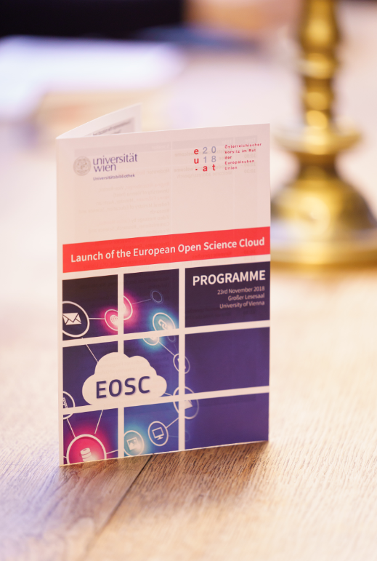
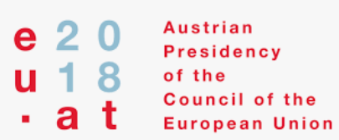
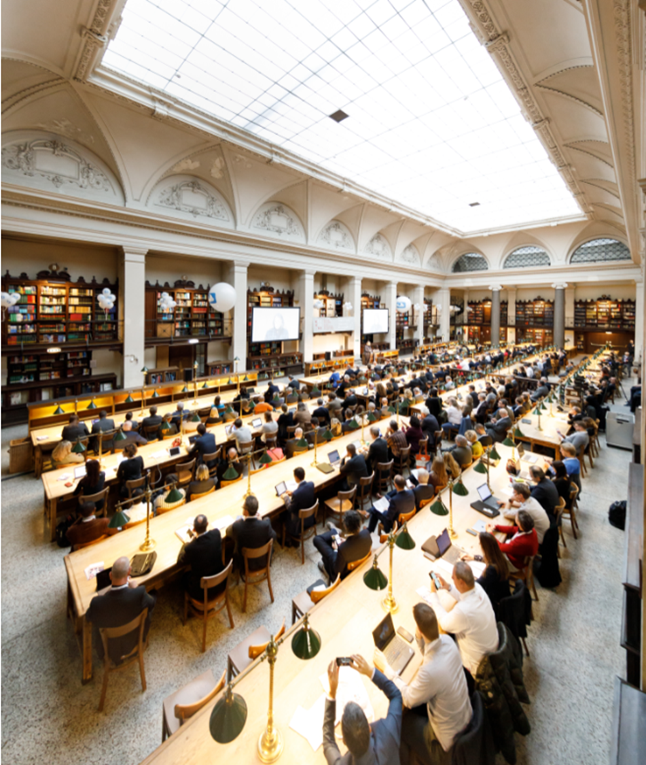

EOSC launch event in Vienna on 23 November 2018
Symbolic start of the implementation phase 2018-2020
Interim EOSC governance structure in place
Preliminary prototype of the EOSC Portal for the researchers
Testimonials by the scientific communities
Vienna Declaration
Commissioner Carlos Moedas:
“The future of Europe will be open, digital, and interdisciplinary"
Director-General Jean-Eric Paquet (DG R&I):
“FAIR is the common language of the science Cloud”
“Let's make the European research data commons a reality”
“The Science Cloud gives a lively example of
European co-design and co-creation”

Slide 3
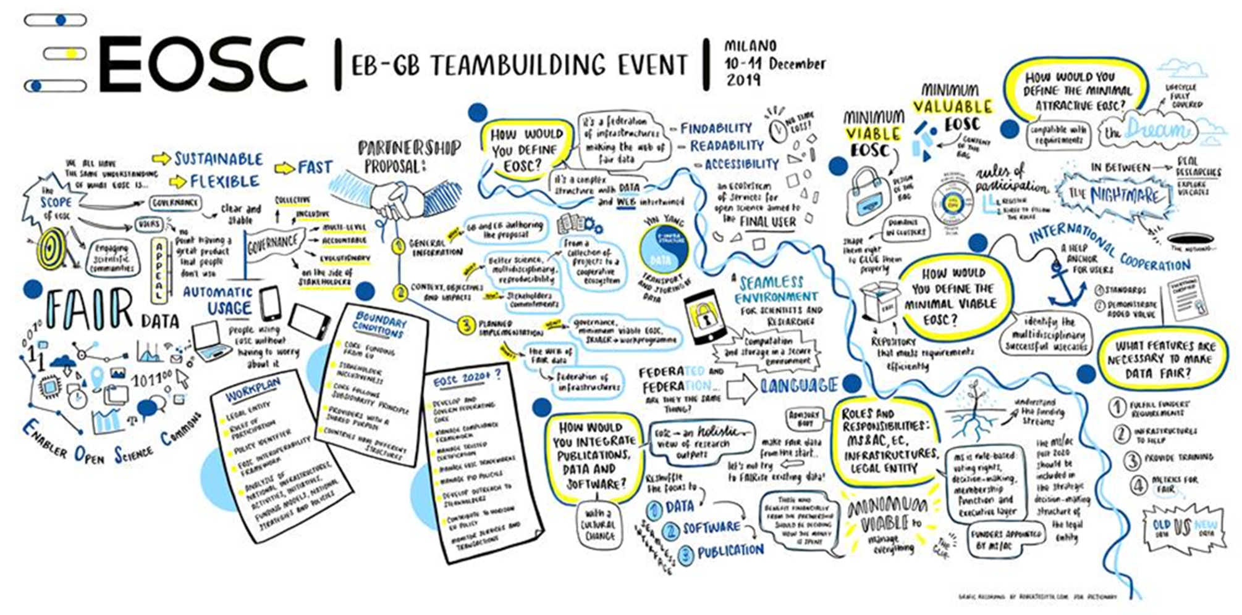
2019: From where to start ?

Slide 4

The EOSC jigsaw puzzle
Being cross-border and cross-disciplinary by vision,
EOSC addresses a multifaceted landscape:
Different practices and standards by different communities. Many bespoke
solutions. There is no ‘one-size-fits-all’ approach that can be applied to
interoperability, and composability of resources across disciplines.⁽¹⁾
The components needed to create a first generation EOSC are largely
there but they are lost in fragmentation and spread over 28 Member
States and across different communities.⁽²⁾
Need to link resources, coordinate and agree about common specifications and standards and to enable brokering across disciplines to break down silos. ⁽³⁾
We need to commence defragmentation actions immediately ⁽²⁾
Sources:
¹ EOSC Future: D3.2a - EOSC Architecture and Interoperability (2022)
² EC study Realising the EOSC (2016)
³ EC study Turning FAIR into practice (2018)

Slide 5
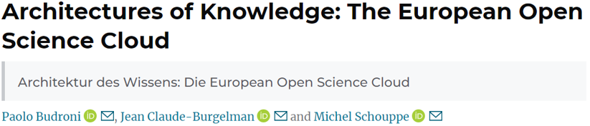

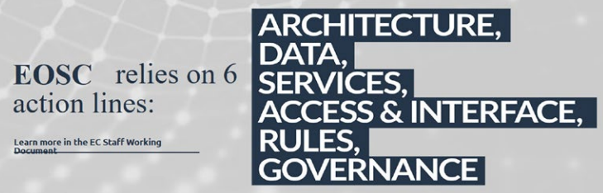
Need for an “Architectures of knowledge: the EOSC”
2019
EOSC: a process, not a project
EOSC is not a cloud “made in Brussels”
Vienna declaration: a landmark and a starting point
Introduction to the governance 2019-2020
Key issues:
  EOSC as a key policy for creating a European research commons
  Brokerage of different interests
  Coordination of EOSC-related initiatives and projects
  Moving to the operational phase of the implementation
  Positioning the EOSC in a global and evolutive context

Slide 6
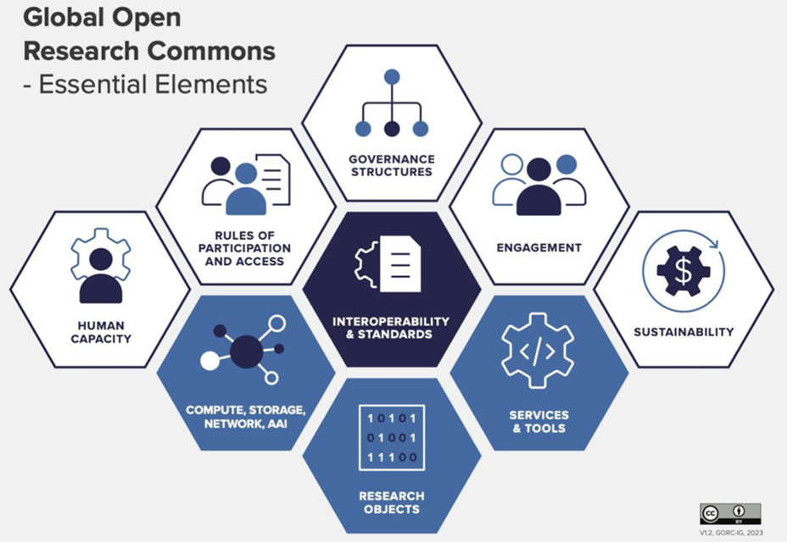
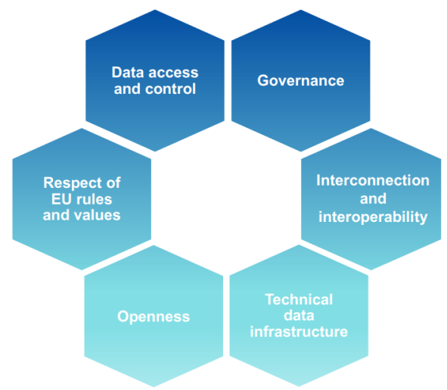
How to build a Research Commons?
Conceptual models for global research data commons
based on best practices at international level
(including EOSC)
Source: RDA GORC, https://doi.org/10.15497/RDA00087
Design principles for common
European data spaces
(including EOSC)

Slide 7
Progress on EOSC Governance since 2018
EOSC phase 1: preparatory
EOSC phase 2: continued EOSC rollout
EOSC phase 3
2018 - 2020
2021 – 2027 (2030)
Post-2027
Grants’ approach in H2020
Partnership approach in Horizon Europe
Trends (tbc)
- Renewed EOSC Tripartite collaboration
- Strengthened participation of the Member States
- Higher level of integration and synchronisation by the three Parties (at EU, national, Institutional levels)
- Flexibility matters as much as integration
- Indirect management by an external entity of some/all EOSC Tasks after 2027
EOSC roadmap
by the EC
Strategic Research & Innovation Agenda (SRIA) by the EOSC community
Interim EOSC Governance
(EC, Member States - Associated Countries, experts from the research community)
EOSC Tripatite Governance
(EC, Member States - Associated Countries,
EOSC Association)
Launch event in Vienna
2nd EOSC Declaration
(AT Presidency of the EU)
Assessment of EOSC Phase 1
3rd EOSC Declaration
(DE Presidency of the EU)
Preparatory steps for EOSC post-2027
(SP Presidency of the EU)

Slide 8
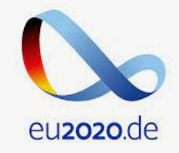





Political momentum towards EOSC gained since 2018
EU political support:
2020: Declaration “Opening the Door to a World of FAIR Research Digital Objects - On the Threshold to the European Open Science Cloud” by the DE Presidency of the EU
2021: Declaration “Riding the Next Wave of Research Data” by the PT Presidency of the EU
2022: Council conclusion on “Research Infrastructures” and the Brno declaration under the CZ Presidency of the EU
2023: The Lund declaration by the Swedish presidency “Maximising the Benefits of Research Data” (2023)
Also important:
2021: Council conclusions on “The future governance of the European Research Area (ERA)” under the Slovenian Presidency of the EU
2022: Council conclusion on “Research assessment and implementation of Open Science” under the FR Presidency of the EU

Slide 9
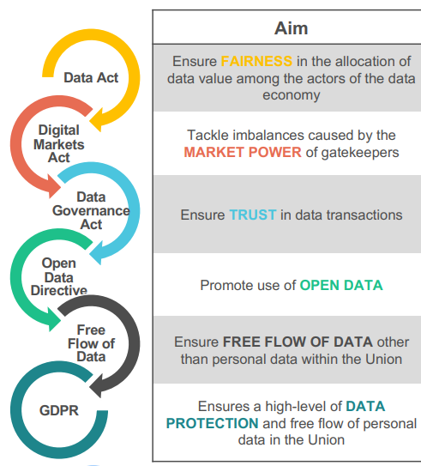

EOSC-relevant policies, strategies and legislations
EU level
2019: Directive on open data and the re-use of public sector information
2020: European strategy for data
2022: Data act proposal by the EC
National policies
Open access to publications: 23 out of 40 countries
Research data: 10 out of 40 countries
Open source software: 6 out of 40 countries
Services through EOSC: 6 out of 40 countries
Source: EOSC Observatory
developed by EOSC Future
and launched in 2022

Slide 10



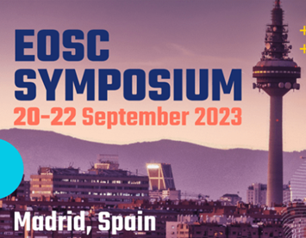
EOSC engagement since 2018
New EOSC Association:
Formed on 29th July 2020 with four founding members
to represent the voice of the research community
Non-EU partner in the EOSC European Partnership
Has grown to more than 250 Members and Observers
  Research Performing Organisations: 65%
  Service Providers for Research: 24 %
  Research funding organisations: 6%
  Other: 5%
Courtesy of the EOSC Association
Series of annual EOSC Symposia since 2019:
500+ participants in Madrid, 33 sessions, around 100 speakers/panelists
National tripartite events targeting
28 countries in 2022 and 2023
2200+ national participants
360+ speakers, moderators, panelists

Slide 11


Turning FAIR into practice: some examples
FAIR data Maturity Model (2020):
Capitalise on RDA stakeholders and expertise to:
  Build on existing approaches and expertise
  Set core assessment criteria for FAIRness
  Provide a FAIR data checklist
FAIR data maturity model as an RDA Recommendation
FAIR assessment tools: Towards “Apples to Apples” comparisons
Policy papers by the EOSC Steering Board
Opinion paper on EOSC FAIR data literacy
Opinion paper on FAIR data sovereignty in EOSC
Under preparation: Opinion paper on FAIR data productivity
European Research Data Landscape study (2022):
baseline on FAIR practices in Europe
Only 40% of researchers occasionally store data in research data repositories;
1/3 never heard about FAIR principles; 2/3 develop DMPs but other FAIR-aligned practices much less common
Development of cross-domain FAIR frameworks
Development of thematic FAIR data commons
Many FAIR activities at national and institutional levels

Slide 12
Examples of open and FAIR thematic demonstrators
PANOSC: the photon and neutron open science cloud
Photon and Neutron FAIR Data Commons: PaN Data Portal - https://data.panosc.eu
FAIR data policy and DMPs → 90% of PaN RIs (15)
Standardised metadata (Nexus/HDF5) → ALL PaN Ris (18)
Federated search API for data catalogues → 8 PaN RIs
Open Data portal for FAIR data → 8 PaNs RIs
Community AAI UmbrellaId → 90% PaN RIs (15)
JupyterLab notebooks service → 90% PaN RIs, 100s users daily
Nexus/HDF5 web visualization → ALL PaN RIs, 1000s worldwide
Remote data analysis with VISA → 8 PaN RIs, 100s users monthly
Simulation software (ViNYL) → 4 PaN RIs, 10s users monthly
PaN-learning platform (pan-learning.org) → 100s users monthly
The European COVID-19 Data Portal:
Launched in April 2020 by EMBL-EBI, ELIXIR, the EC and other partners
Over 20.000.000 data records
Accessed by over 300,000 users in 187 countries/areas
BlueCloud 2026: Blue Cloud data lakes for ocean sustainability
Blue Cloud 2026 is implemented as a System of Systems promoting Open Science
Federated Data Discovery & Access Services (currently more than 10 million)
About 1500 users per month
The new Pathogens Portal
Operated by EMBL-EBI

Slide 13
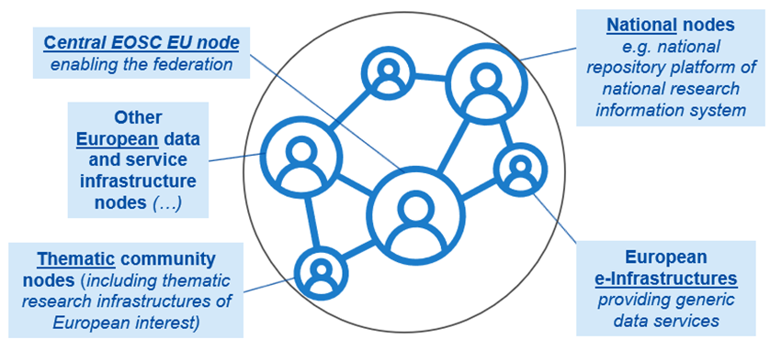
EOSC Federation of research data infrastructures
  Many basic functionalities for the EOSC Federation have been tested by EOSC Future (H2020):
  The Authentication and Authorization Infrastructure
  The Policy framework on Persistent Identifiers
  The Interoperability Frameworks
  The common search and access engine
  Security Coordination
  Monitoring and accounting modules
Different policies are being investigated by the EC and the EOSC Association
Acceptable Use Policy targeting consumers of EOSC resources
Rules of Participation targeting all service providers / node operators
Access policy (for identified users; defining the resources and capacities available to them and under what conditions)
  EC procurement for “Managed services for the EOSC platform” (HE)
  Fully operational, secure, cloud-based EOSC infrastructure and services with functionalities available 24/7 for the duration of 36 months
  Access to a rich portfolio of FAIR (Findable, Accessible, Interoperable, Reusable) data and professional quality interoperable services

Slide 14
Conclusions
EOSC is a transformative, collaborative process in action
To accelerate Open Science, FAIR data management and use of digital methods and services
To stimulate co-operation in science and research, new insights and innovations, higher research productivity and improved reproducibility in science.
Bringing together the European Commission, the national governments and the many R&I stakeholders involved in the European Research Area
EOSC is on its way to expand an open, trusted, federated infrastructure
To enable circa 2 million European researchers to store, share, process, analyse, and reuse research digital objects (e.g. data, publications and software)
« The challenge is not limited to linking datasets; federating infrastructures or aligning policies. It starts by linking people and organisations across the EOSC ecosystem » (Jean-Eric Paquet, Vienna, 2018)

Slide 15


Thank you
The success of EOSC will largely depend on a change of culture among the researchers towards openness. Research funders, like the Commission, are increasingly committed to foster open access, data management along the FAIR principles, as well as incentives and rewards.
© European Union 2023
Unless otherwise noted the reuse of this presentation is authorised under the CC BY 4.0 license. For any use or reproduction of elements that are not owned by the EU, permission may need to be sought directly from the respective right holders.

