Slide 1

The EOSC today and tomorrow: supporting research, innovation & education
Dr Paul Ayris
Pro-Vice-Provost, LCCOS (Library, Culture, Collections & Open Science)
E-mail: p.ayris@ucl.ac.uk
Twitter: @ucylpay

Slide 2

Contents
Global commitments
  Sorbonne Declaration
The EOSC landscape
Benefits
Challenges
Conclusions
UCL - University College London (1826)

Slide 3

Sorbonne Declaration
Led by UCL on behalf of LERU
Statement of principles
University commitments
Call for global research community to adopt
Supporting actions at (inter)national levels
https://www.leru.org/files/Sorbonne-declaration.pdf

Slide 4
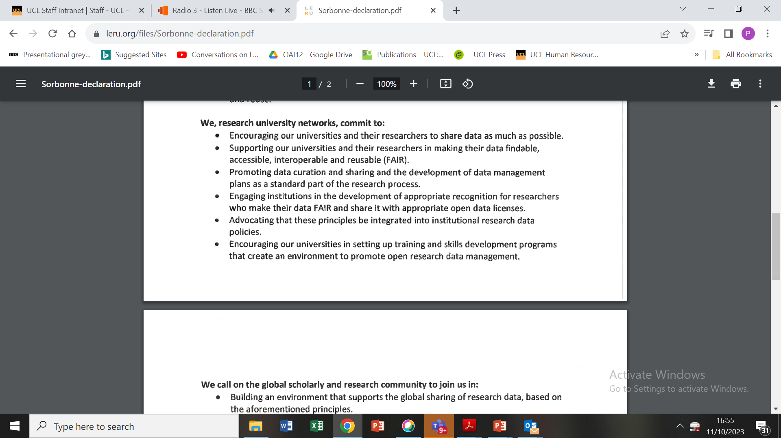
Key clauses

Slide 5
Contents
Global commitments
  Sorbonne Declaration
The EOSC landscape
Benefits
Challenges
Conclusions
UCL - University College London (1826)

Slide 6
Exchange (blue)
Interoperability (grey)
Support (orange)
Core (green)

Slide 7
EOSC architecture
EOSC Exchange (blue) includes services and data sources onboarded to EOSC by research infrastructures, clusters and projects, serving the needs of one or more research communities as well as the general public and private sector.
EOSC Core (green) contains enabling services required to operate the EOSC and the coordination functions.
EOSC Interoperability Framework (grey) identifies standards and guidelines that each service can and should comply with to increase the ability of users to connect services into more powerful and useful combinations.
EOSC Support activities (orange) complement the other services and include services such as training and the Digital Innovation Hub.

Slide 8
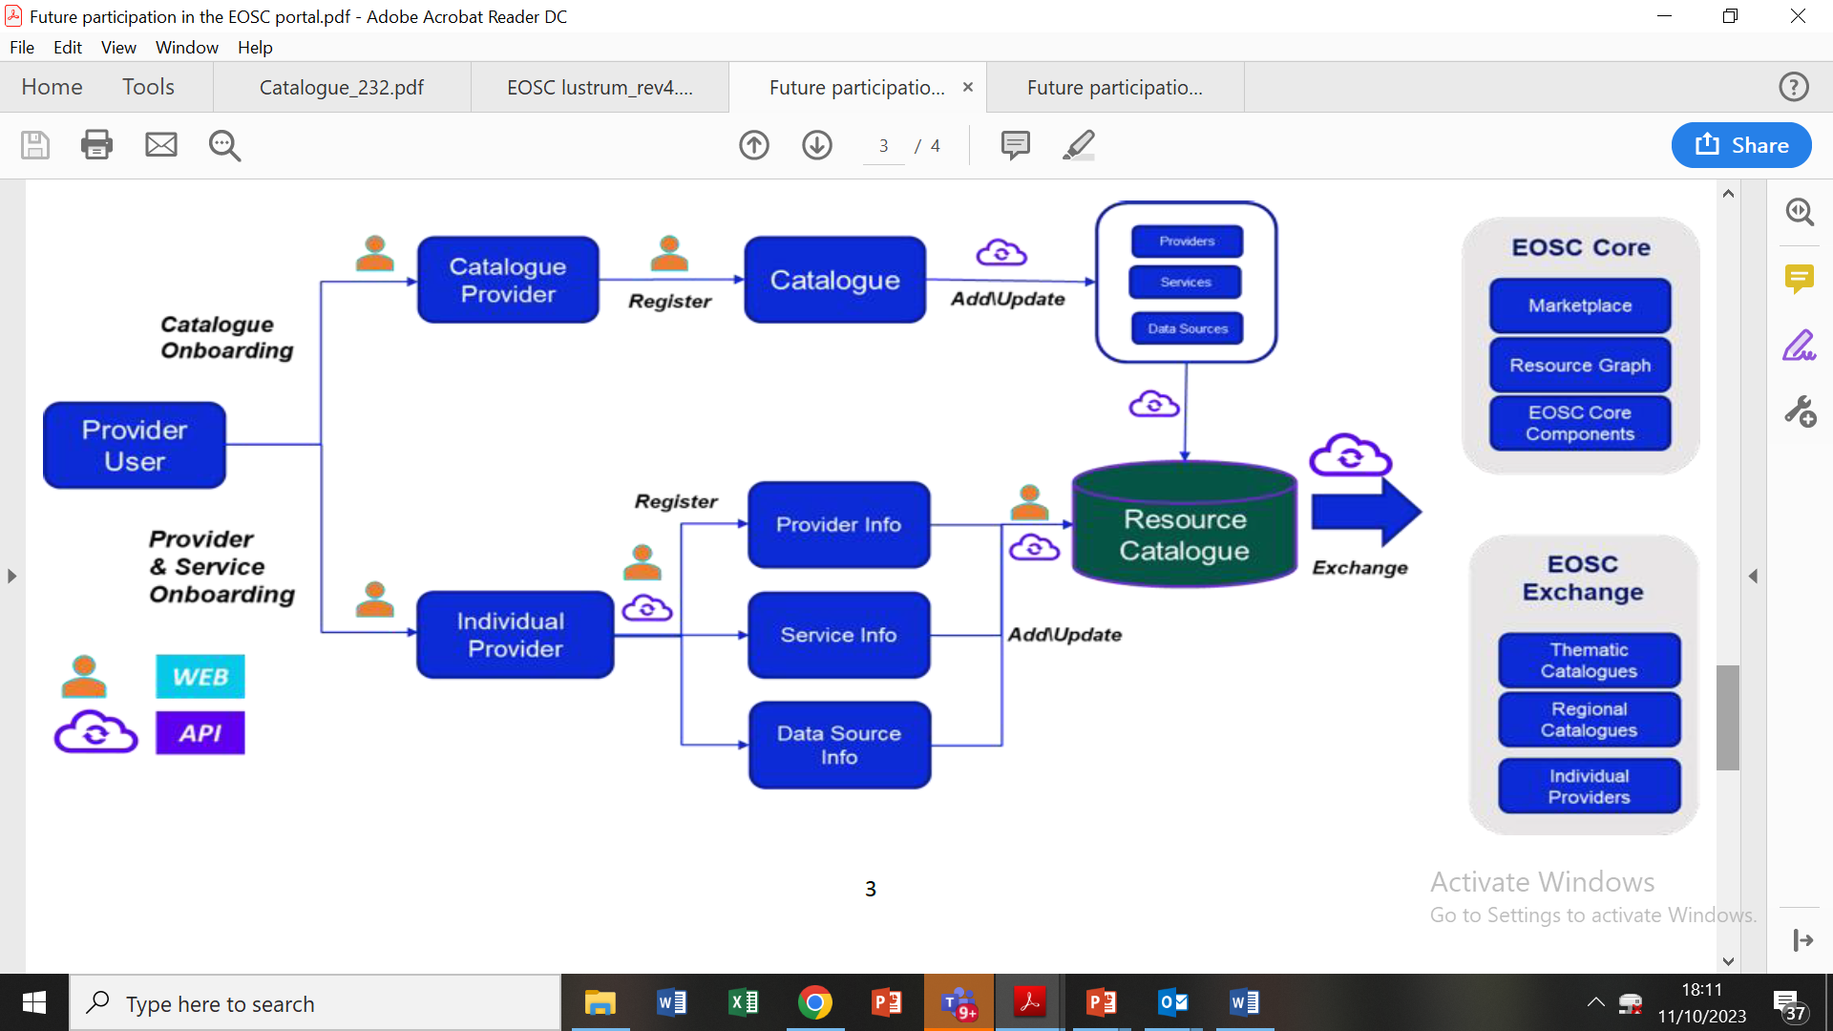
The On-boarding workflow for EOSC

Slide 9
Contents
Global commitments
  Sorbonne Declaration
The EOSC landscape
Benefits
Challenges
Conclusions
UCL - University College London (1826)

Slide 10
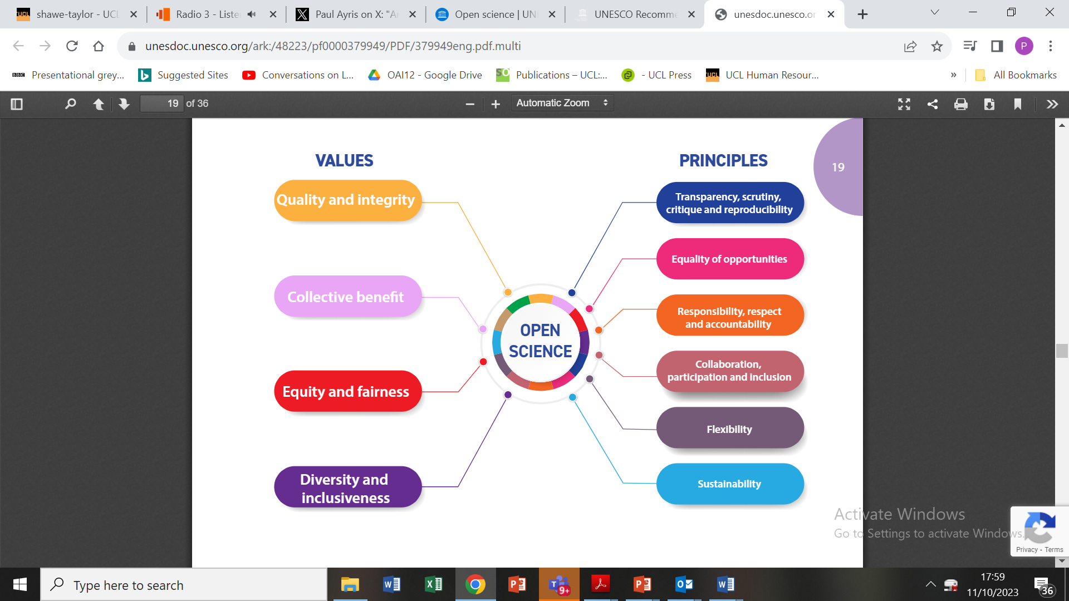
Aligned with the UNESCO Recommendation on Open Science
https://unesdoc.unesco.org/ark:/48223/pf0000379949

Slide 11
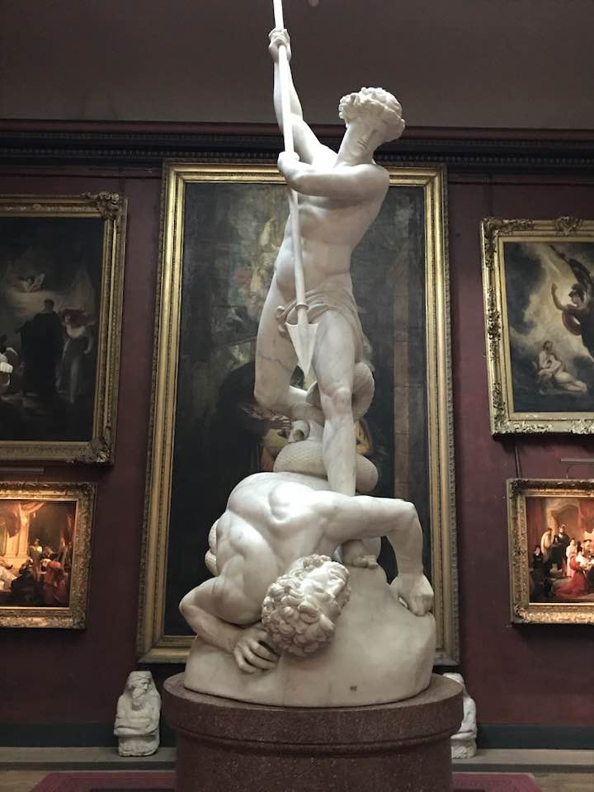
Benefits
Encourages sharing as an intrinsic part of undertaking research activity
Avoids duplication of activity
  Potentially speeding up research outcomes
  Can result in cost savings
Supports equity in the research landscape
Helps to create a new research culture grounded in openness
John Flaxman: St Michael overcoming Satan, Petworth House

Slide 12
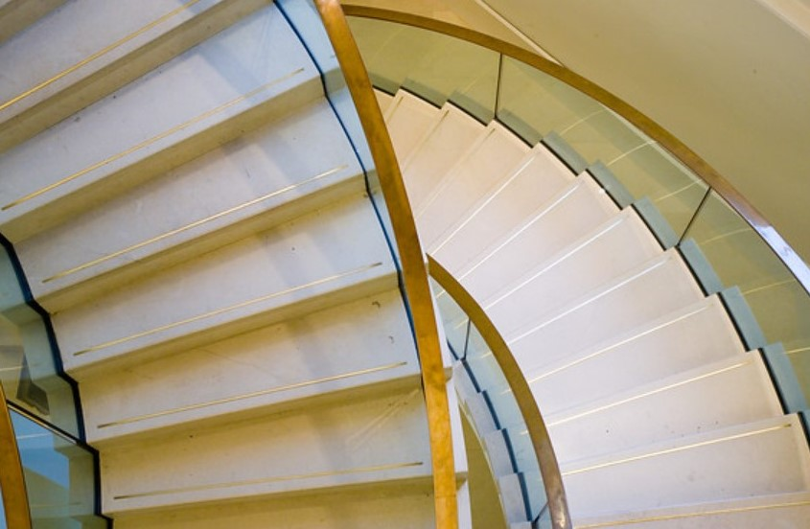
Challenges
Roads to engagement
  Uploading to EOSC was iterative & difficult?
Research Culture
  Case for an EOSC-style aggregator fully accepted by all subject disciplines?
Europeana https://www.europeana.eu/en has low visibility. How can we make the EOSC different?
Pathways…
Finance
  Not all universities can currently fund the necessary infrastructure developments

Slide 13
Contents
Global commitments
  Sorbonne Declaration
The EOSC landscape
Benefits
Challenges
Conclusions
UCL - University College London (1826)

Slide 14
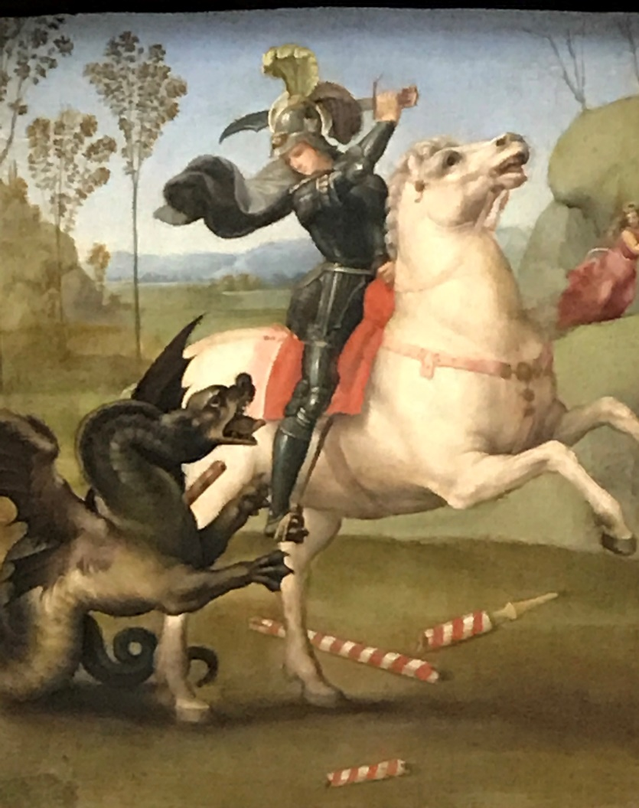
Conclusions
EOSC has enormous potential to enrich research, innovation & education
Supports the global UNESCO Open Science Recommendation
Helps to deliver a change in research culture
Some challenges remain as the EOSC grows in scope
SHARING
Raphael: St George and the Dragon. Louvre/Albertina Exhibition
(Vienna, November 2017)

